Slide 1
Missionary Care
Holy and gracious Heavenly Father, we pray for our missionary Judith as she shares the Gospel in Thailand. Among Thailand's 70 million people, Christians make up less than two percent. May the Spirit of the Lord anoint Judith with creative ways to proclaim Christ in local school and the communities where she lives. We give thanks for the
1/2

Slide 2
Missionary Care
Christmas event she hosted in her own home last December. Through crafts, films, and games, she shared the Gospel of Jesus Christ with many people. We ask the Heavenly Father to raise up future Thai Christian preachers and leaders from among these individuals. In the name of our Lord Jesus Christ, Amen.
2/2

Slide 3
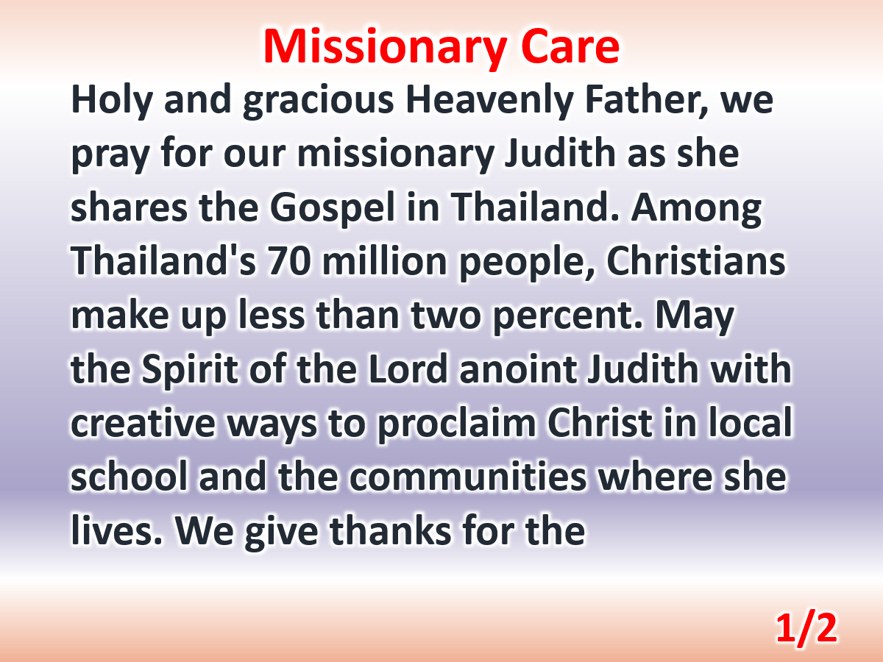

Slide 4
