Slide 1
Missionary Care
Almighty God, we pray for the missionary couple Matthew and Diana in Japan, along with their two little children. In the coldest month of January in Hokkaido, we ask You to keep them safe and in good health. We pray especially for the salvation of the souls of the indigenous Ainu people of Hokkaido. We ask the Heavenly Father to strengthen the
1/2

Slide 2
Missionary Care
missionaries' hearts, enabling them to overcome all obstacles as they proclaim the Gospel to the Ainu and the Japanese people. May the Holy Spirit work within the hearts of the Ainu and Japanese peoples, softening them to clearly understand that Jesus is the living water spring of eternal life. In the name of our Lord Jesus Christ, Amen.
2/2

Slide 3
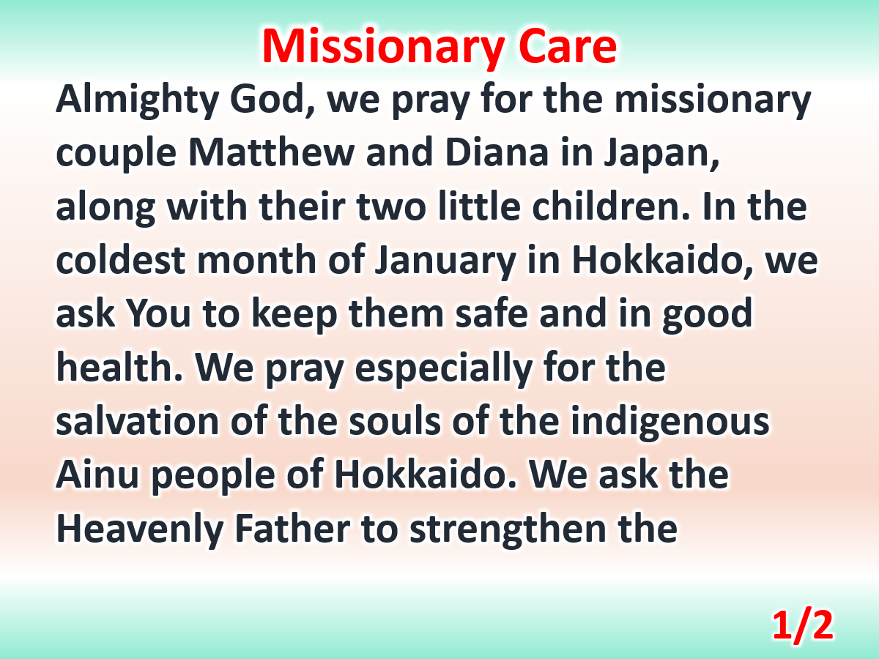

Slide 4
