Slide 1
Missionary Care
Dear Heavenly Father, we give thanks for the ministry of Jacky and Iris among refugees in Southeast Asia. In 2026, their son will enter the three-year-old class at a local kindergarten. We pray for God's protection as he adjusts to school life. Jacky has been appointed Head of Discipline for the secondary section at the
1/2

Slide 2
Missionary Care
Refugee Education Centre in the new year. He will manage numerous administrative duties while teaching mathematics and multicultural peace and unity courses across two classes. May the Holy Spirit anoint him to balance work, ministry and family life, serving joyfully to accomplish great things for the Lord. In the name of our Lord Jesus Christ, Amen.
2/2

Slide 3
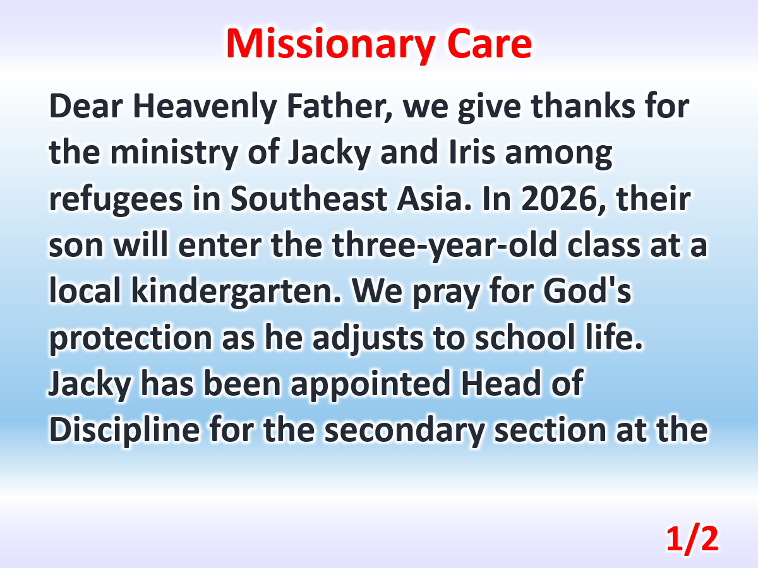

Slide 4
