Slide 1
Missionary Care
Heavenly Father, since May this year, a series of military clashes have erupted between Cambodia and Thailand over territorial disputes. We pray for a peaceful resolution between the two nations, as the conflict has already forced 520,000 Cambodians to flee their homes.
1/3

Slide 2
Missionary Care
We ask Jehovah Shalom to protect Sister Yu Chen Chen, our missionary in Cambodia, granting her safe passage through these turbulent times. May the Holy Spirit fill the churches throughout Cambodia, empowering them to be peacemakers who mend divisions and
2/3

Slide 3
Missionary Care
transform the nation at this critical juncture. Send forth new labourers for both short-term and long-term missions to Cambodia. In the name of our Lord Jesus Christ, Amen.
3/3

Slide 4
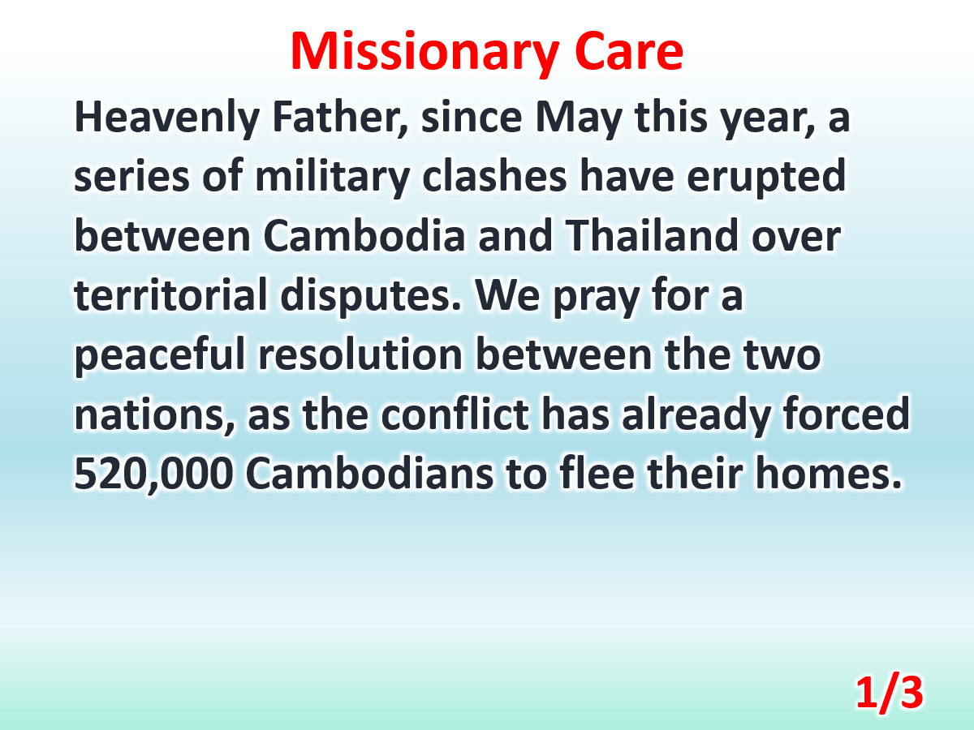

Slide 5
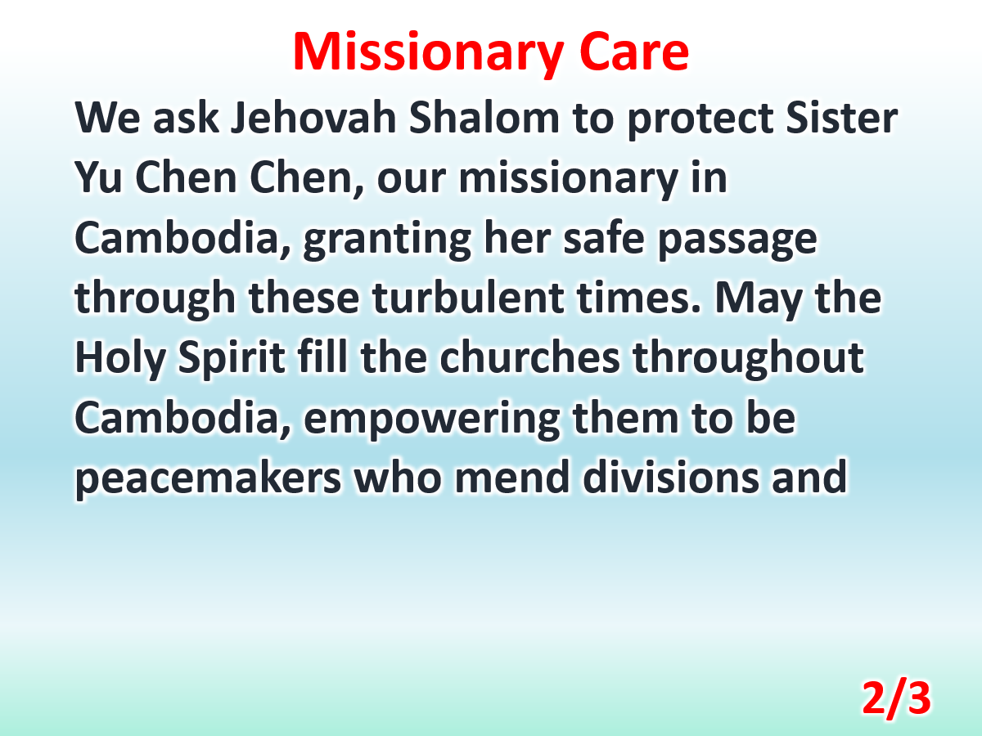

Slide 6
