Slide 1
Missionary Care
Glorious God, we thank You for being with our missionary Joanne. Many children from Indochina attended the Christmas programme she prepared, hearing the good news of Jesus Christ. Though this nation remains closed to the Gospel, the commercial atmosphere of Christmas has become a valuable bridge for sharing the Good News, granting missionaries
1/2

Slide 2
Missionary Care
opportunities to proclaim it. We pray that God anoint all the Christmas ministries carried out by Joanne and her team. She is now preparing to relocate to another city to embark upon new ministry. We ask our Heavenly Father to watch over her for a safe and smooth move, that wherever she goes, Christ may be magnified in her as always. In the name of our Lord Jesus Christ, Amen.
2/2

Slide 3
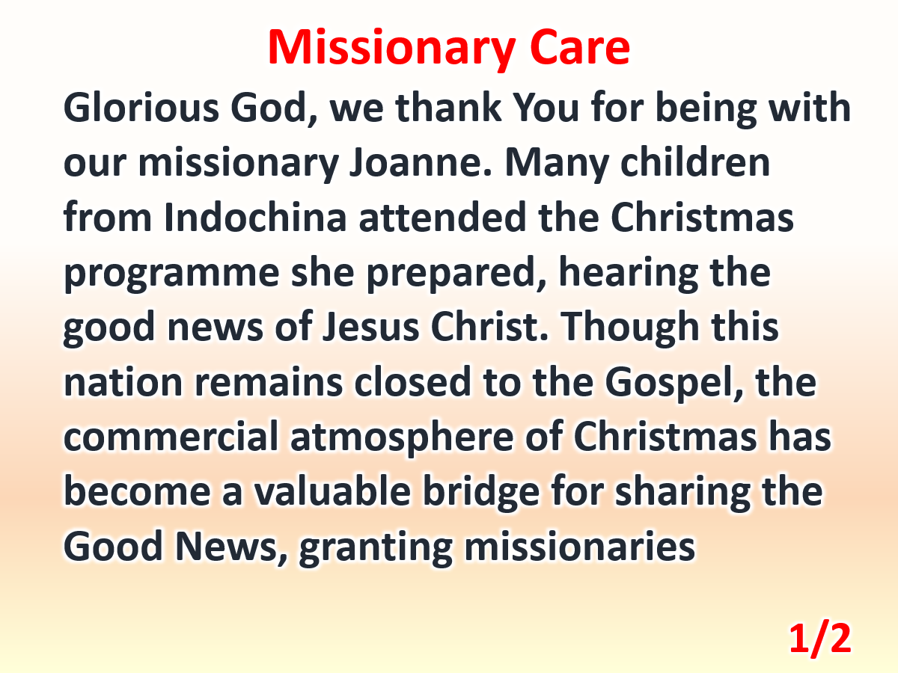

Slide 4
