Slide 1
Missionary Care
Omnipresent God, we thank You for preparing a way for our missionary couple Oreo to secure new work visas. As they minister to the stateless M people group in Southeast Asia, frequently visiting and caring for them in harsh and rudimentary conditions, we ask for Your protection over them. They are exploring suitable contextualised strategies to lead
1/2

Slide 2
Missionary Care
the stateless M people group to Christ and train them as disciples of Jesus. May the Holy Spirit anoint them and their local co-workers. Mr. Oreo is particularly concerned for his elder brother's mental and emotional state back home. We ask Jehovah-Shalom to heal and take care of him. In the name of our Lord Jesus Christ, Amen.
2/2

Slide 3
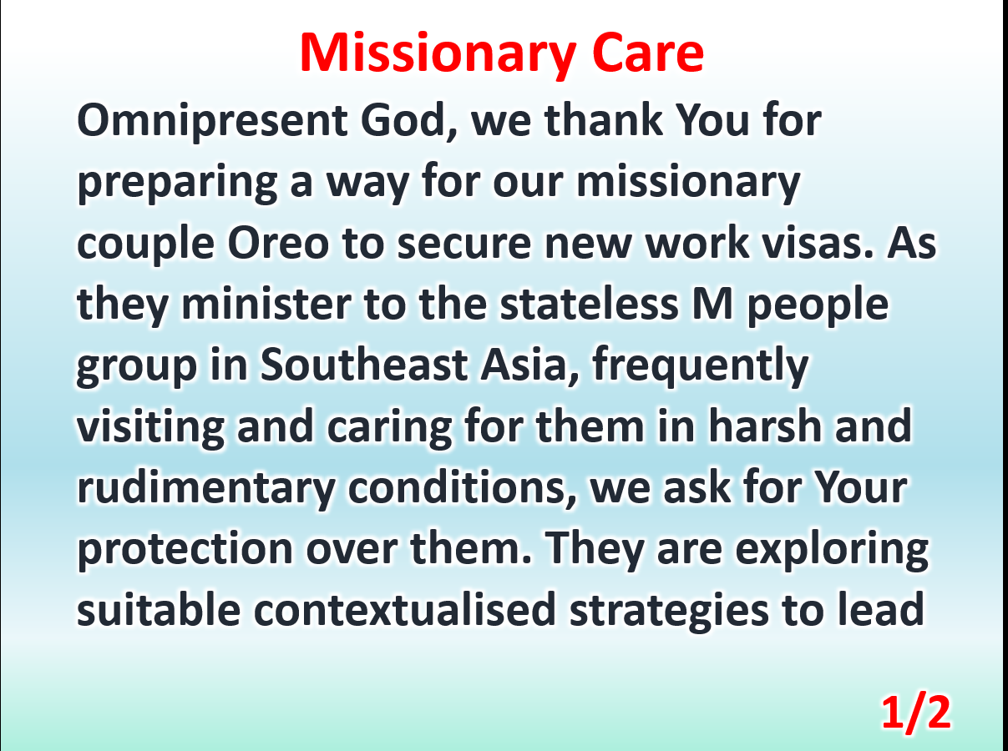

Slide 4
