Slide 1
Missionary Care
Faithful God, Your grace is new every morning! We pray for Your blessing upon our missionary Reverend Hii Kong Ching and his wife. We especially ask Jehovah Jireh to provide new employment for Reverend Hii's daughter Maria, Jehovah Nissi to guide Gloria in completing her master's degree, and Jehovah Shalom to
1/2

Slide 2
Missionary Care
bless Debbie as she advances in her music and dance profession. May the fresh anointing of the Holy Spirit enable Reverend Hii's family to serve God with joy and strength. We pray this in the name of our Lord Jesus Christ. Amen.
2/2

Slide 3
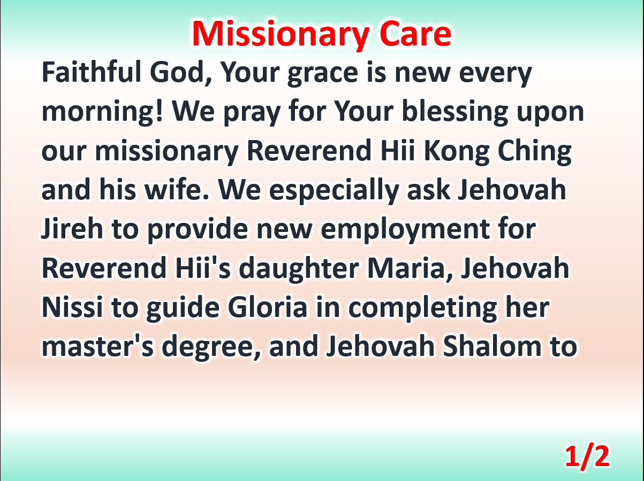

Slide 4
