Slide 1
Missionary Care
Glorious Heavenly Father, we thank You for Your care over Reverend Hii Kong Ching and his family as they begin new ministry in a new District in London, shepherding Shern Hall Methodist Church and Woodford Methodist Church. Recently, Reverend Hii attended his first circuit meeting in the new district.
1/3

Slide 2
Missionary Care
He observed that most of the attending lay preachers were over seventy years old. He also heard discussions about declining church membership, aging buildings, and plans to sell vacant churches or partner with organizations—all matters of deep concern. We earnestly pray that the Holy Spirit will
2/3

Slide 3
Missionary Care
use Reverend Hii and his wife to lead the renewal and revival of the churches, raising up a new generation within the British Methodist Church. May the Heavenly Father also bless the pastor's three daughters, granting them grace in both their work and ministry. In the name of our Lord Jesus Christ, Amen.
3/3

Slide 4
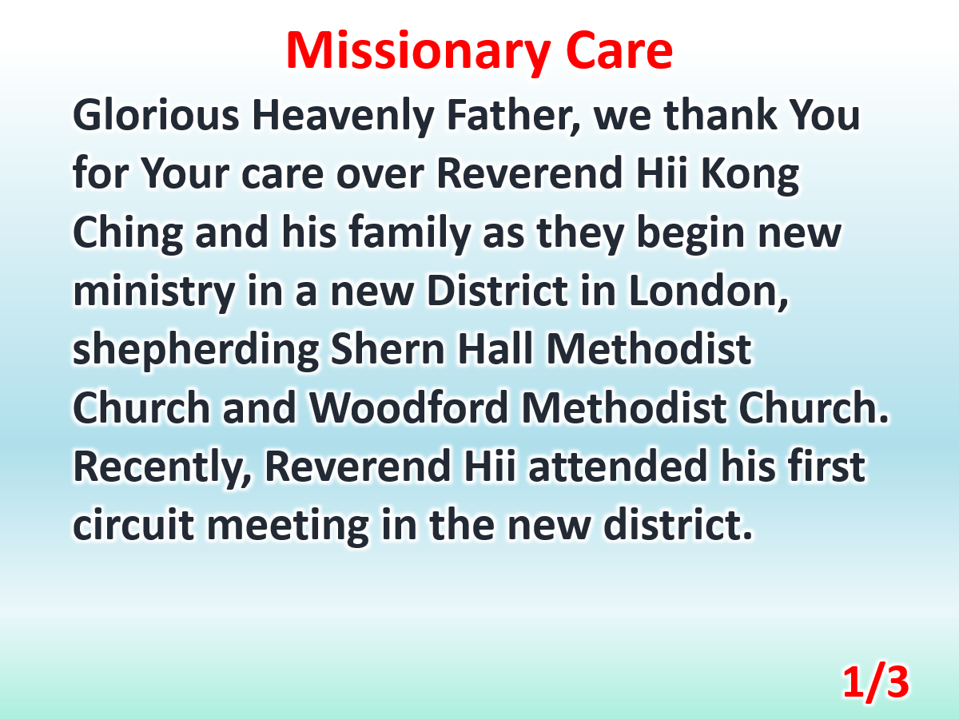

Slide 5
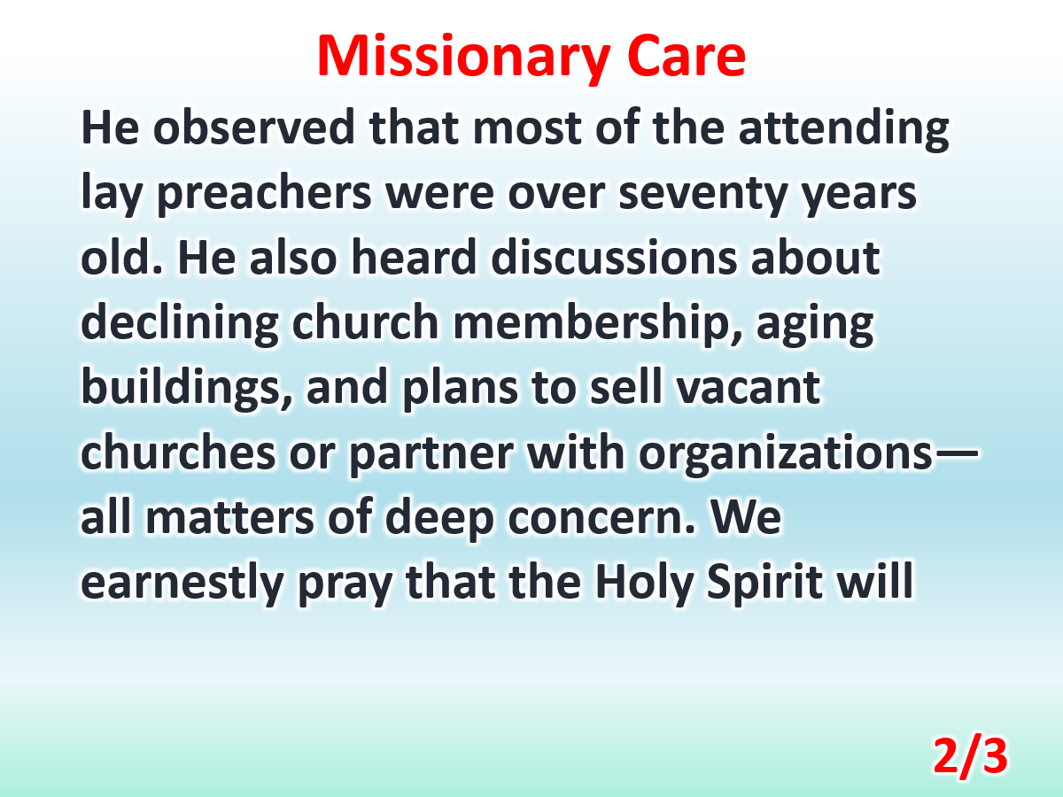

Slide 6
