Slide 1
Missionary Care
Glorious Heavenly Father, we thank You for protecting our missionary Chieng in Thailand as she enters her second year teaching at a local school. Among Thailand's 70 million people, only 1.2 percent are Christians. May God's kingdom come into the lives of Thai people, may spiritual revival come upon
1/3

Slide 2
Missionary Care
local Christians, and may people from all thirty-plus ethnic groups come to trust in Jesus Christ. We are thankful that Jehovah Jireh has recently provided encouragers for Chieng in the missions field. They are an elderly missionary couple from the United States and the Philippines. They fellowship with Chieng
2/3

Slide 3
Missionary Care
and inspire one another. May the Holy Spirit move more Christians in Sarawak to have a spiritual burden for Thailand and go for long-term missions. In the name of our Lord Jesus Christ, Amen.
3/3

Slide 4
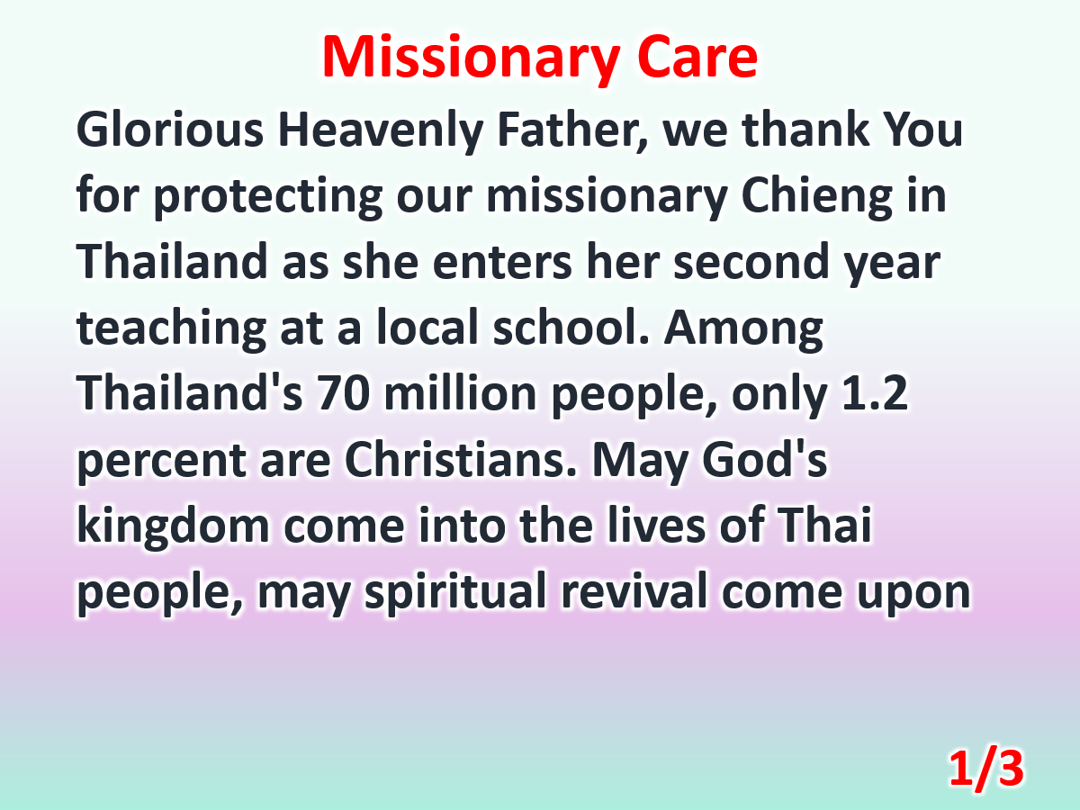

Slide 5
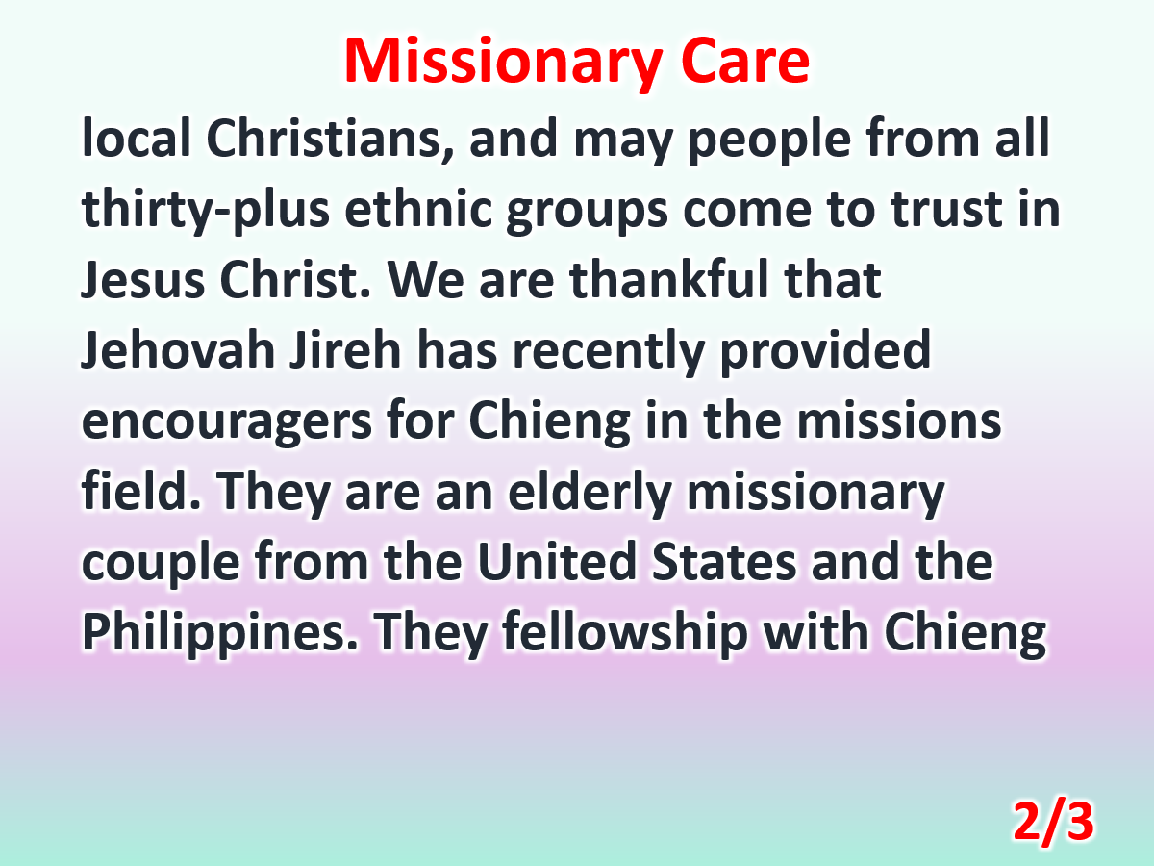

Slide 6
