Slide 1
Missionary Care
Our faithful Heavenly Father, we thank You for anointing missionary Hui Hua to successfully prepare the cultural festival at the Refugee Learning Center, allowing students to wear their traditional cultural attire and enjoy a joyful time. In October, Hui Hua will host a short-term missions team from Miri. We ask the Holy Spirit to work mightily, enabling team members
1/3

Slide 2
Missionary Care
to experience God's miraculous presence, gain deeper understanding of the missions field, and even inspire some to commit to short-term or long-term missions. In October, Hui Hua and her co-workers also organize a pickleball event for refugee students, specifically providing nearby churches with an opportunity to connect with the
2/3

Slide 3
Missionary Care
students. We pray that God will use this event to help the refugees experience the great love of Jesus Christ. We also ask the Lord to grant Hui Hua the grace of peaceful sleep each night and a strong, healthy body. In the name of our Lord Jesus Christ, Amen.
3/3

Slide 4
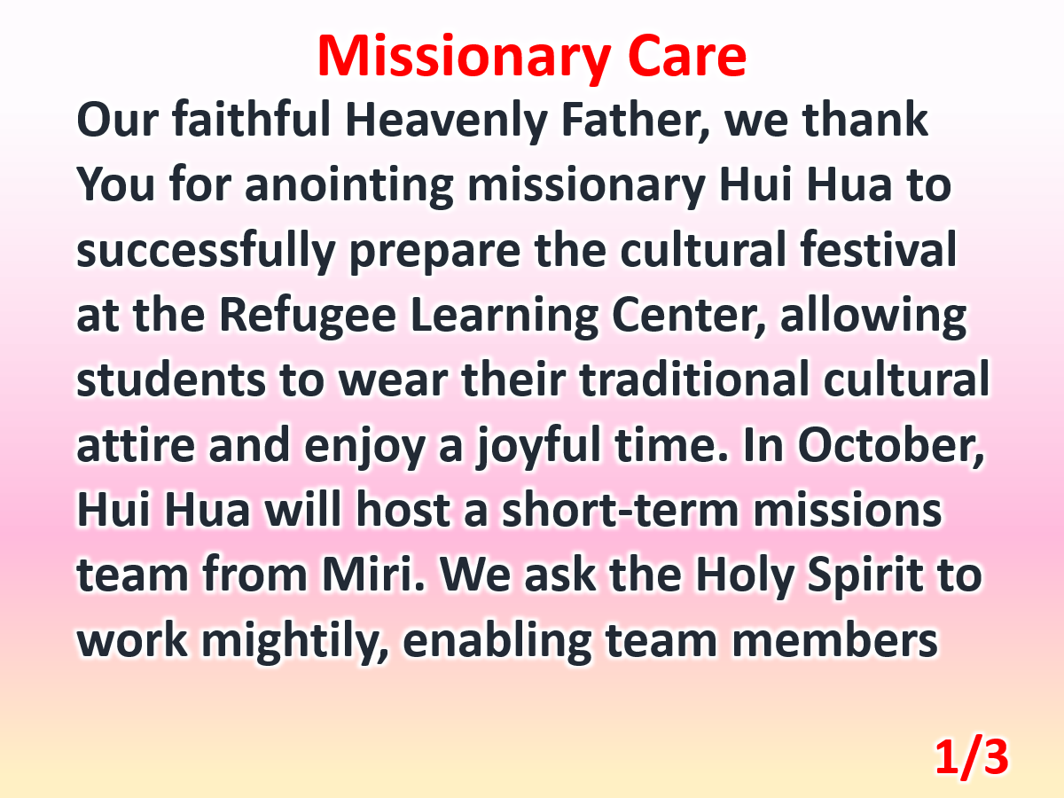

Slide 5
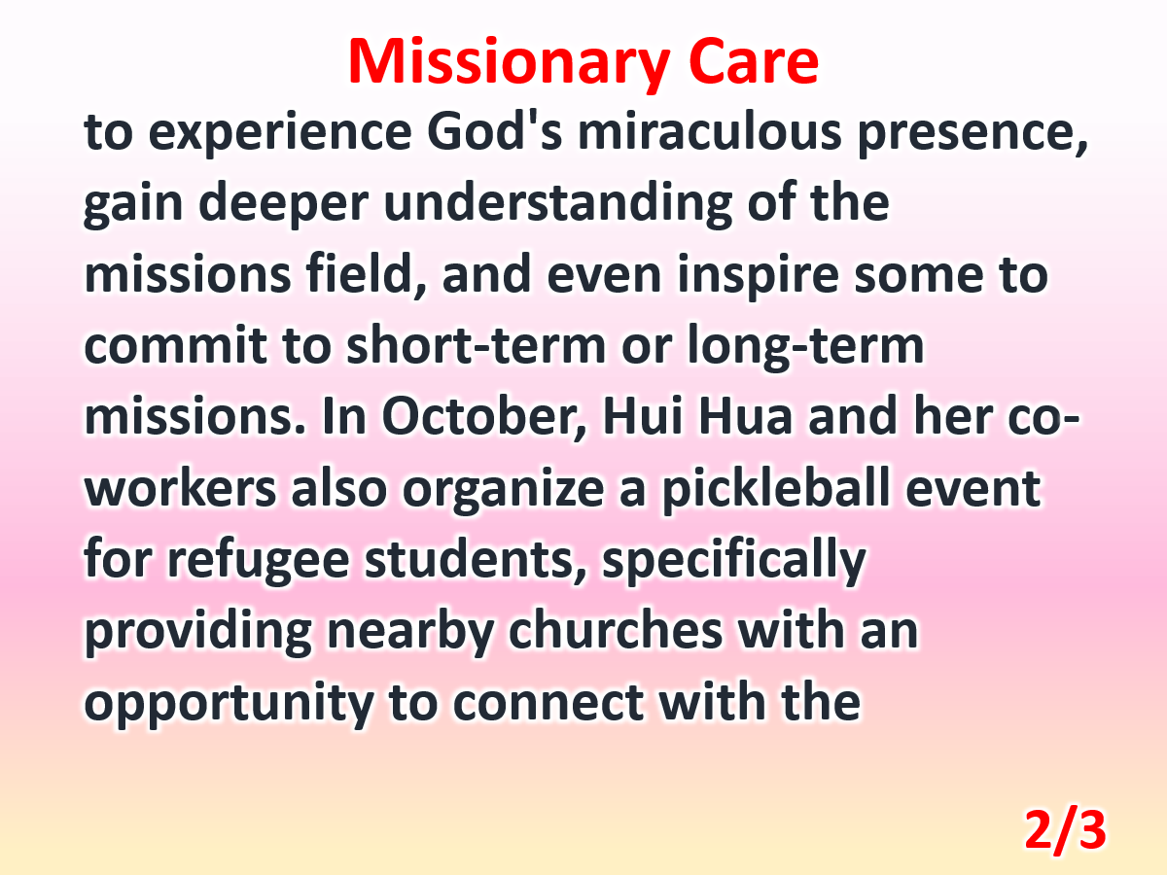

Slide 6
