Slide 1
Missionary Care
Merciful Heavenly Father, we thank You for leading our missionary Dorothy Yet to share about the plight of stateless children with multiple churches in Sabah and Sarawak throughout July and August. May the Holy Spirit use her message and testimony to move many to commit to long-term or short-term missions works among the stateless children and
1/2

Slide 2
Missionary Care
refugees. In September, Dorothy hosted two short-term missions teams who visited the stateless students' families to offer care, prayer, and evangelism. May the Lord establish the work of their hands. May the Lord also continue to grant Dorothy health and vibrant spiritual life to fight the good fight for the Gospel. In the name of our Lord Jesus Christ. Amen.
2/2

Slide 3
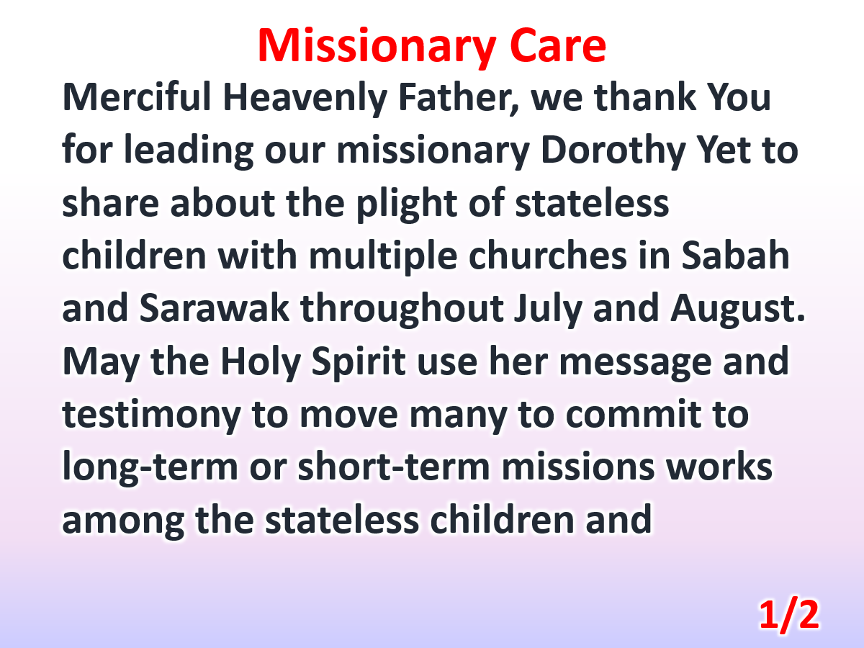

Slide 4
