Slide 1
Missionary Care
Merciful Heavenly Father, You love Nepal, a nation of nearly thirty million people, only about half a million of whom are Christians. Recently, large-scale protests led by young people have erupted across Nepal, causing widespread unrest. We ask You, Heavenly Father, to watch over missionaries from various countries who
1/3

Slide 2
Missionary Care
are sharing the Gospel in Nepal, especially Joe and Cornie and their young son. May the precious blood of our Lord Jesus Christ cover them, granting them safety in all their comings and goings and good health. We further pray that the Holy Spirit will open the spiritual eyes of the Nepalese people during this turmoil,
2/3

Slide 3
Missionary Care
enabling them to recognize that Jesus Christ is the Way, the Truth, and the Life. May the Holy Spirit also anoint Nepalese pastors and Christians, empowering them to be peacemakers amidst the unrest. In the name of our Lord Jesus Christ, Amen.
3/3

Slide 4
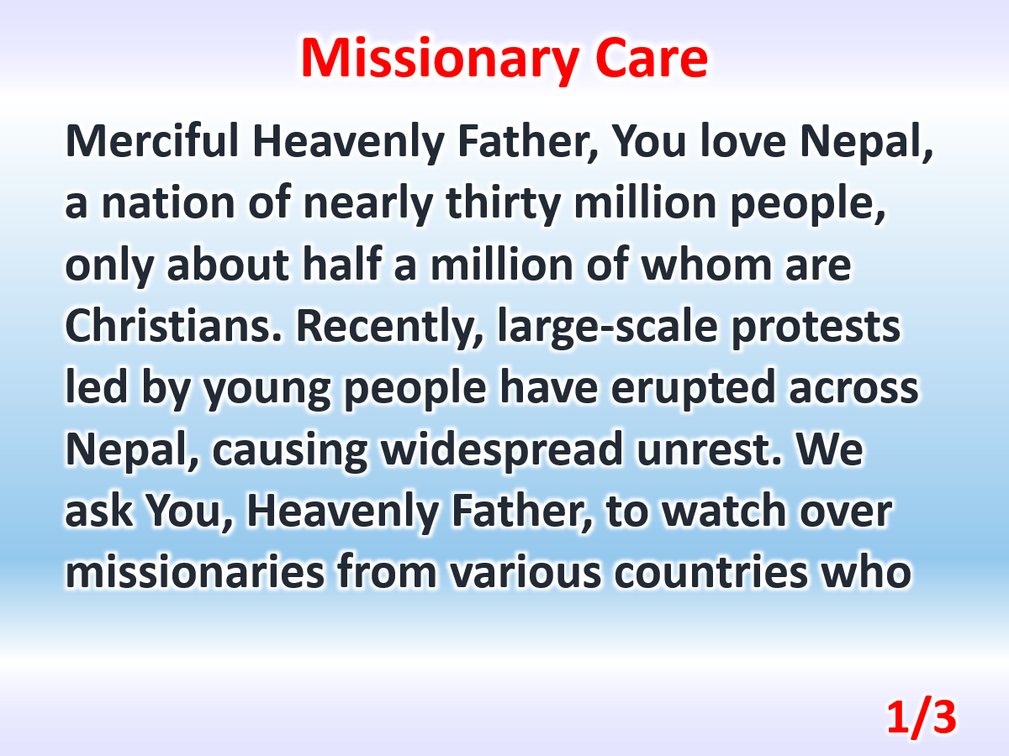

Slide 5
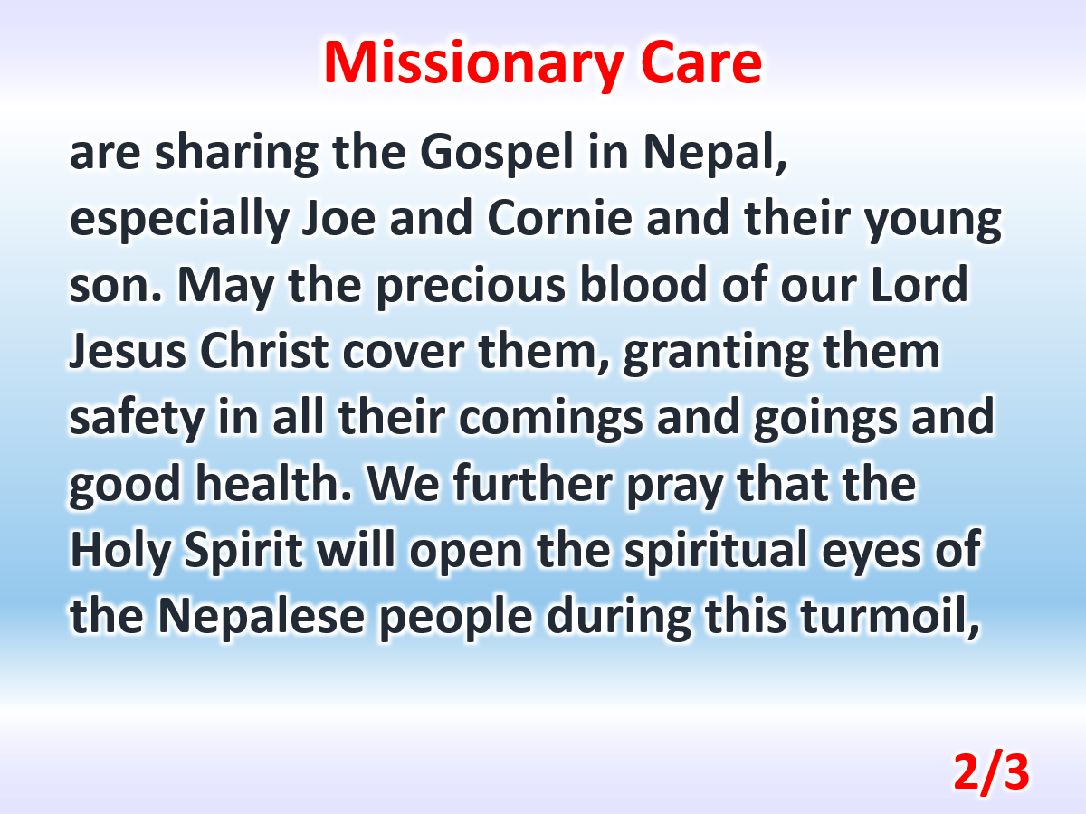

Slide 6
