Slide 1
Missionary Care
Omnipresent Heavenly Father, You love Indonesia, the nation of a thousand islands, home to 280 million people, 87% of whom are Muslim. Recently, nationwide anti-government protests erupted in Indonesia. May God show mercy and grant wisdom to those in authority, that they may reflect the
1/3

Slide 2
Missionary Care
people's voices in their policies. Please, O God, watch over our missionary Ung Sing Ngiik in Indonesia and the communities she ministers to. Following Indonesia's government transition last year, immigration policies changed. Our missionary's one-year visa has expired. Though she began the renewal process
2/3

Slide 3
Missionary Care
months ago, there has been no resolution. Sing Ngiik has now left the country but continues teaching online. May God make a way for her to return to her missions field in Indonesia soon. In the name of our Lord Jesus Christ, Amen.
3/3

Slide 4
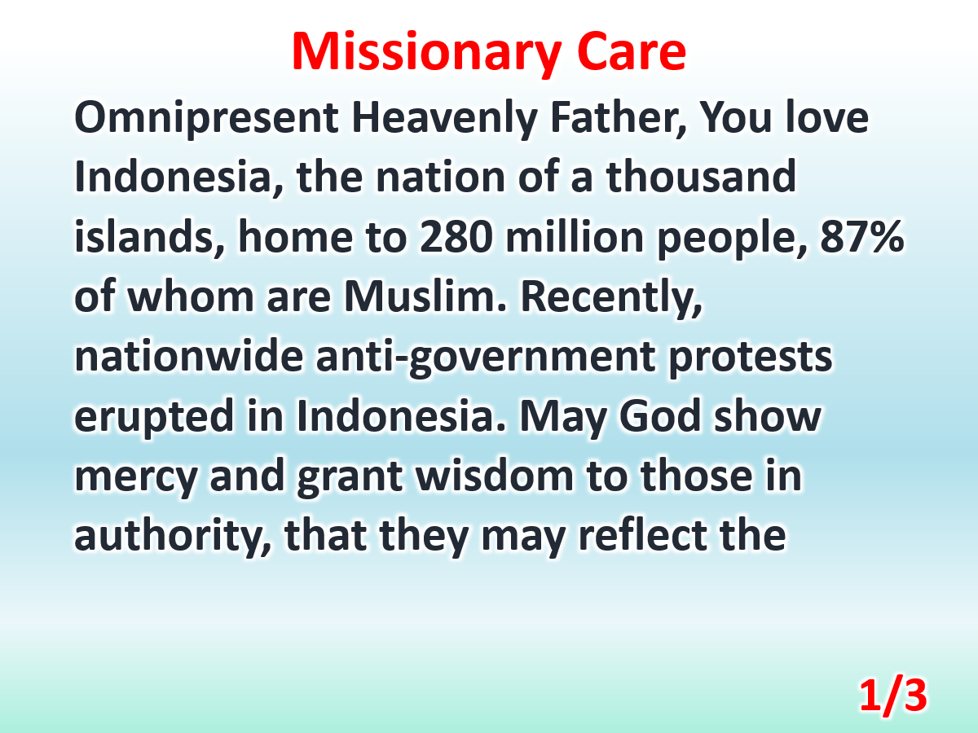

Slide 5
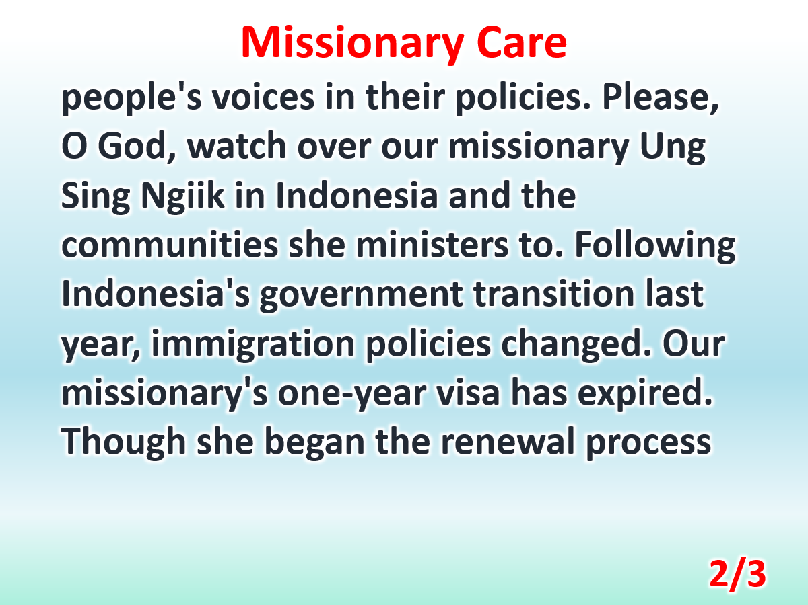

Slide 6
