Slide 1
Missionary Care
Dear Heavenly Father, thank You for blessing Yvonne Law, who has entered the second semester of her second year of equipping in the Missiology program at the Methodist Theological School, Sibu. May her life be rooted and built on the Word of God, and her dedication to long-term cross-cultural overseas
1/3

Slide 2
Missionary Care
missions be renewed day by day until she graduates and embarks on the missions field. We are thankful that two young people are currently enrolled to study full time in the Missiology program next year. We ask the Holy Spirit to move more people, three each year, to dedicate themselves to be theologically
2/3

Slide 3
Missionary Care
equipped to be long-term overseas missionaries, so that the unreached people groups may hear the Gospel earlier. In the name of our Lord Jesus Christ, Amen.
3/3

Slide 4
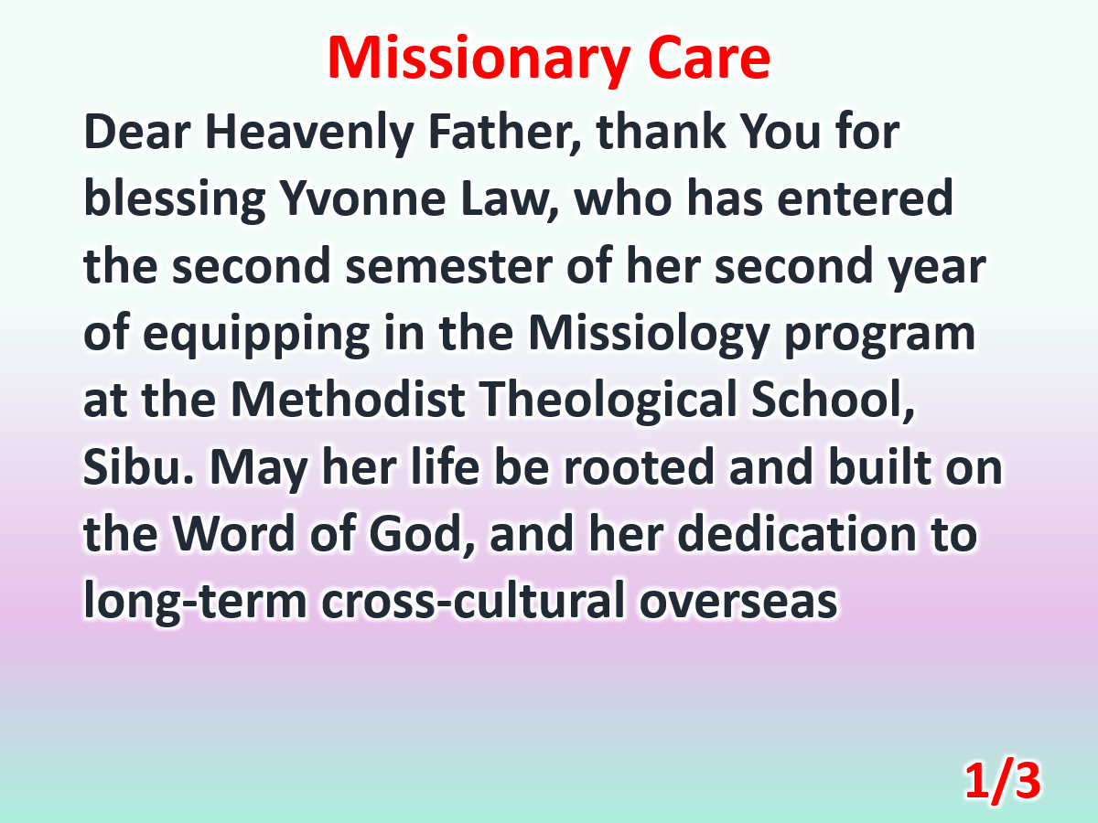

Slide 5
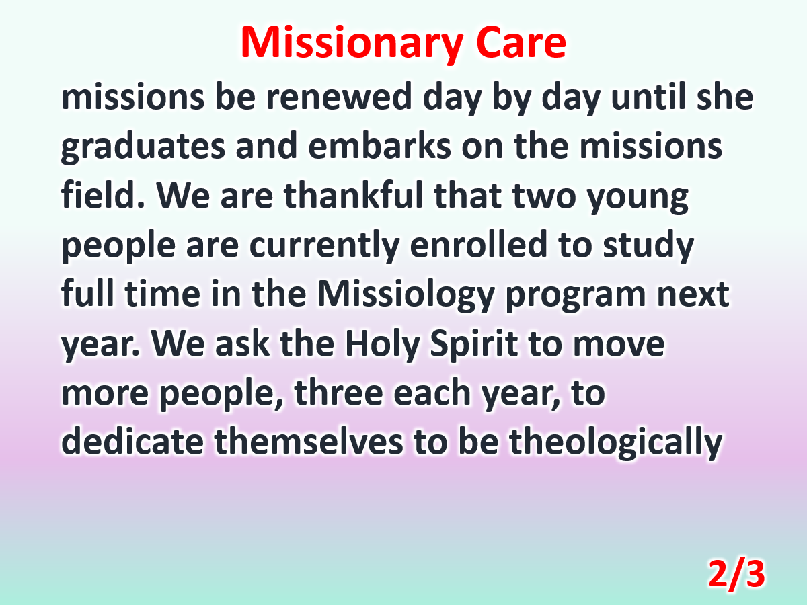

Slide 6
