Slide 1
Missionary Care
Dear Heavenly Father, thank You for leading brother Dunstan from the Trinity Methodist Church in Kuching, who has been on a short-term missions work in Cambodia for eight months. We pray that he will have a healthy lifestyle and be a good example to his students in the midst of his busy teaching schedule.
1/2

Slide 2
Missionary Care
Dunstan desires to serve the unreached people humbly and faithfully. May the Holy Spirit fill him so that he would lead the students fully to Christ. He is preparing for full-time theological equipping. May our Father guide him through the enrollment process. In the name of our Lord Jesus Christ, Amen.
2/2

Slide 3
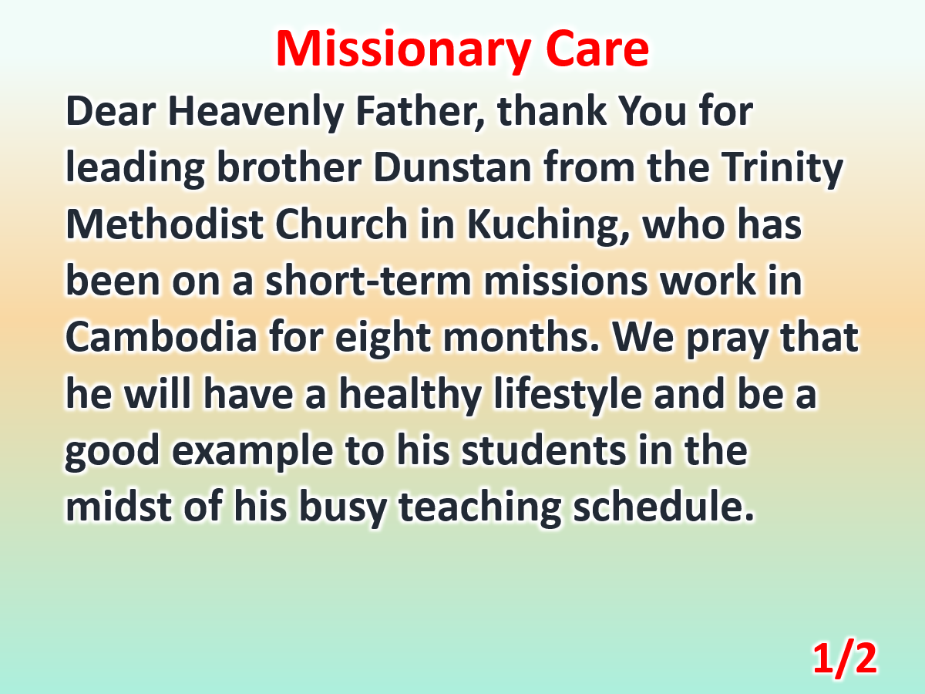

Slide 4
