Slide 1
Missionary Care
Glorious Heavenly Father, thank You for preparing the House of Missions in Sibu to house the missionaries who return from the missions field for debriefing and rest, as well as the full-time director of the Board of Missions . Today, the outdated building needs to be rebuilt. We pray that You lead the whole team of
1/3

Slide 2
Missionary Care
architects, engineers, quantity surveyor and others involved in this project to complete the Lord's work by Your grace. We pray especially that the rebuilt documents will be approved when they are submitted to the authority, that bids will be submitted in the first month of 2026, that construction will begin in
2/3

Slide 3
Missionary Care
February, and that the project will be completed in October, to the glory of the Lord! In the name of our Lord Jesus Christ, Amen.
3/3

Slide 4
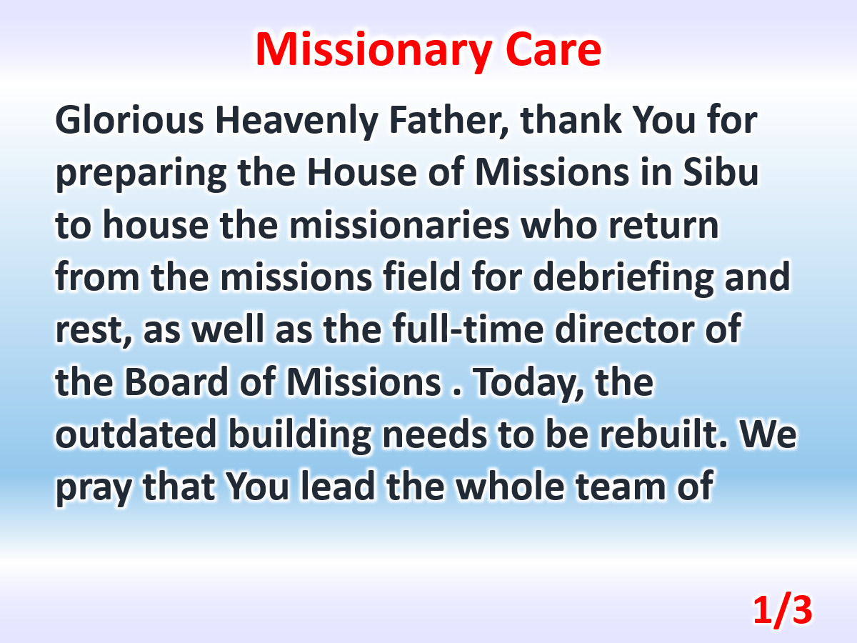

Slide 5
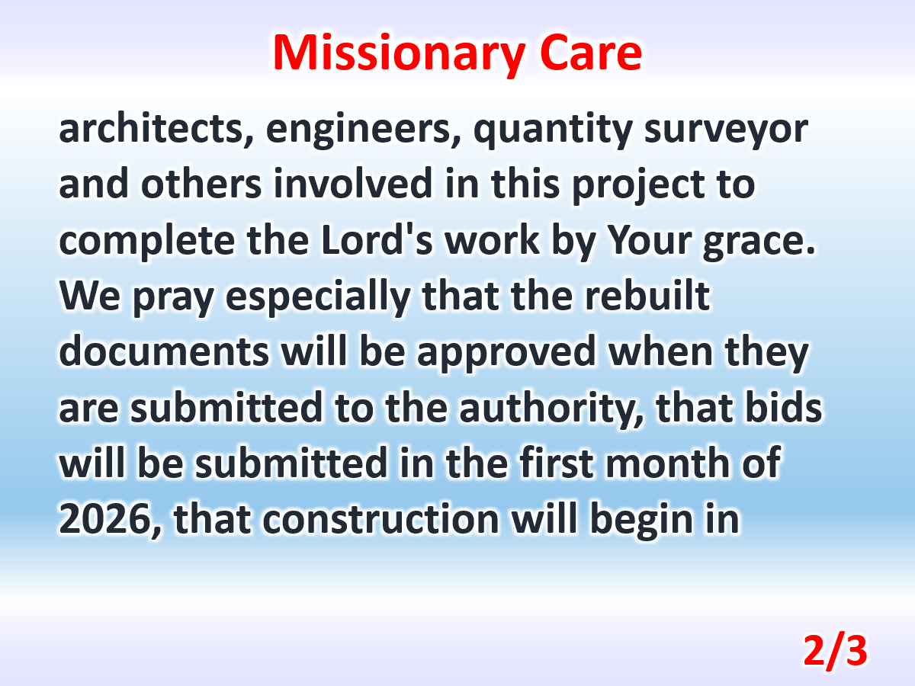

Slide 6
