Slide 1
Missionary Care
Glorious Heavenly Father, thank You for guiding our missionary Hui Hua to serve among the refugee community in Southeast Asia. Not only is she involved in the education ministry, but recently she has been accompanying refugee students and their families to go to the hospitals and police stations, giving practical
1/3

Slide 2
Missionary Care
attention to the plight of the refugees. May God establish the work of her hands and that Jehovah Rapha would heal her persistent cough and bring her to full recovery. We give thanks for the cultural festival held last Saturday at the center that Hui Hua is in charge of, where the students had the opportunity to
2/3

Slide 3
Missionary Care
take charge of the programs, food and games. May all the activities lead the students to the Gospel of Christ. In the name of our Lord Jesus Christ, Amen.
3/3

Slide 4
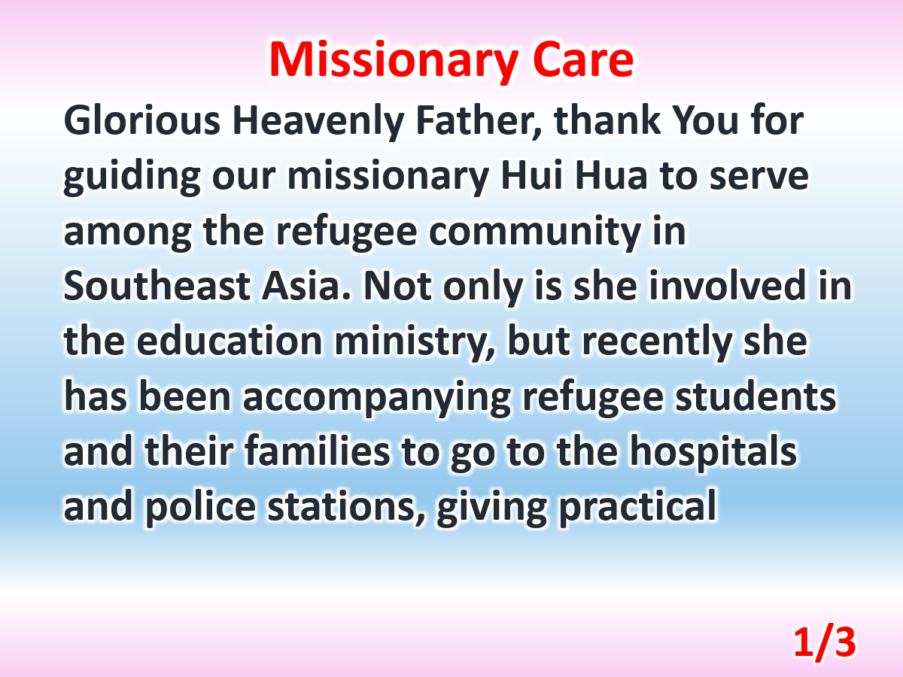

Slide 5
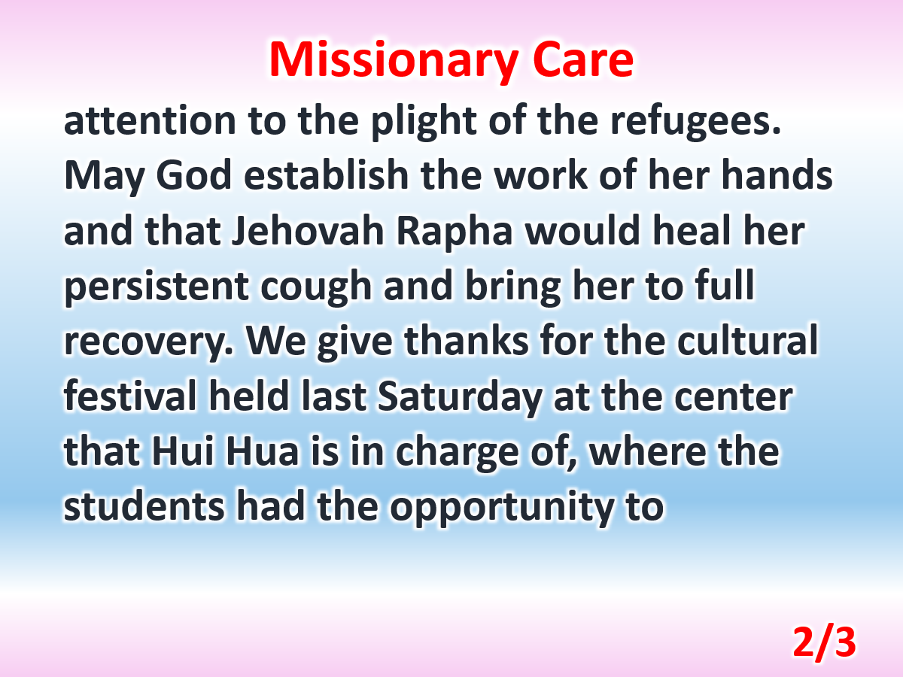

Slide 6
