Slide 1
Missionary Care
Abba Father in heaven, who loves all people, thank You for leading Reverend and Mrs. Hii Kong Ching to pastor the Chinese Methodist Church in London, England for 14 years. In this coming September, he and his wife will begin a brand new journey of pastoring the Shern Hall Methodist Church and Woodford Methodist Church where many members
1/2

Slide 2
Missionary Care
have African background. May the Holy Spirit anoint Reverend Hii and his wife with wisdom and ability in cross-cultural pastoral care, and that they will be able to lead the believers to love the Lord even more, and be passionate in preaching Gospel, being the light and salt in London. In the name of our Lord Jesus Christ, Amen.
2/2

Slide 3
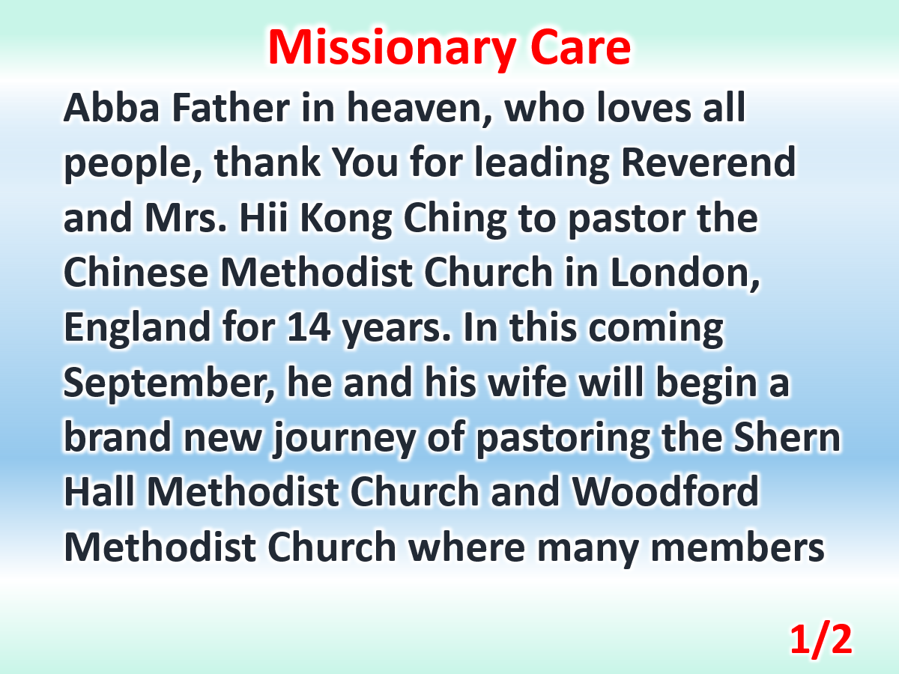

Slide 4
