Slide 1
Missionary Care
Almighty Abba Father, who loves all nations, thank You for leading SCAC new United Kingdom's missionaries, Rev. Linberg Wong and his wife, together with their two sons, to successfully complete two weeks of cross-cultural training. They will be flying to London in August to pastor the King's Cross Methodist Church. May the Holy Spirit fill the family with
1/2

Slide 2
Missionary Care
good health and spiritual strength, that they will settle in smoothly, especially their two little sons. Rev. Wong will be pastoring the Cantonese, Mandarin and English congregations. We ask the Holy Spirit to anoint him with the mind and wisdom of Christ to build a church that is powerful and has a passion for preaching the Gospel. In the name of our Lord Jesus Christ, Amen.
2/2

Slide 3
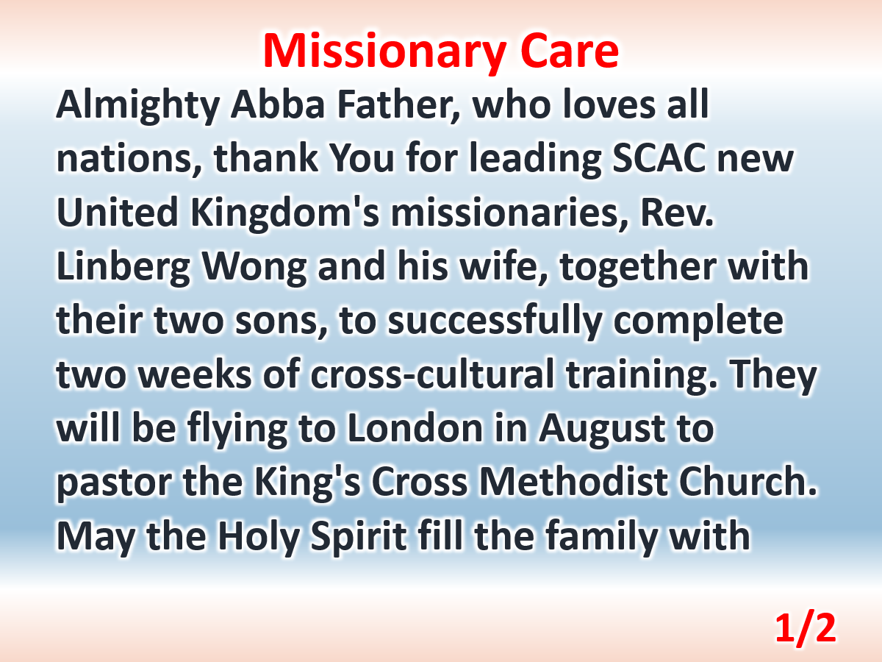

Slide 4
