Slide 1
Missionary Care
Faithful Father God, we thank You for leading our missionary couple, Oreo and their son, during their six-year missions works in East Asia, and now they are undergoing home assignment in Sibu, preparing to leave for their next missions field in September to serve the stateless people in Southeast Asia. We pray especially for him and his wife and little
1/3

Slide 2
Missionary Care
son as they apply for local work and residence visas. We pray that the Lord will make a way for them in the wilderness, that their visas will be approved in time, and that they will have peace of mind for their new missions. We also pray that the Lord will prepare a suitable house for the family to live, so that they can settle in smoothly, and that
2/3

Slide 3
Missionary Care
their son can find a good school and grow up at the missions field. In the name of our Lord Jesus Christ, Amen.
3/3

Slide 4
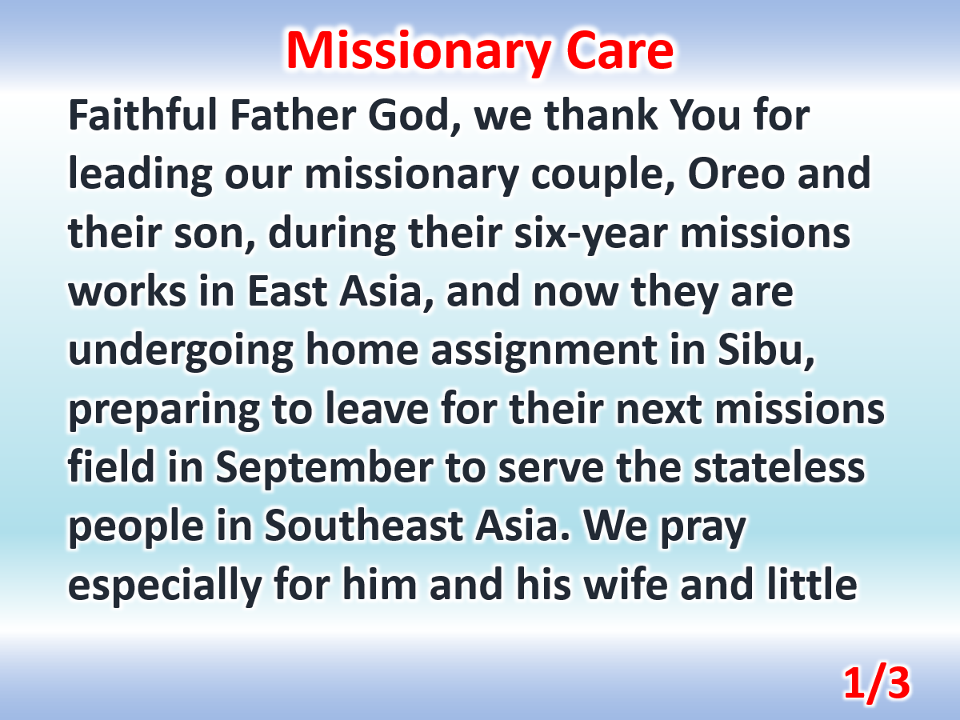

Slide 5
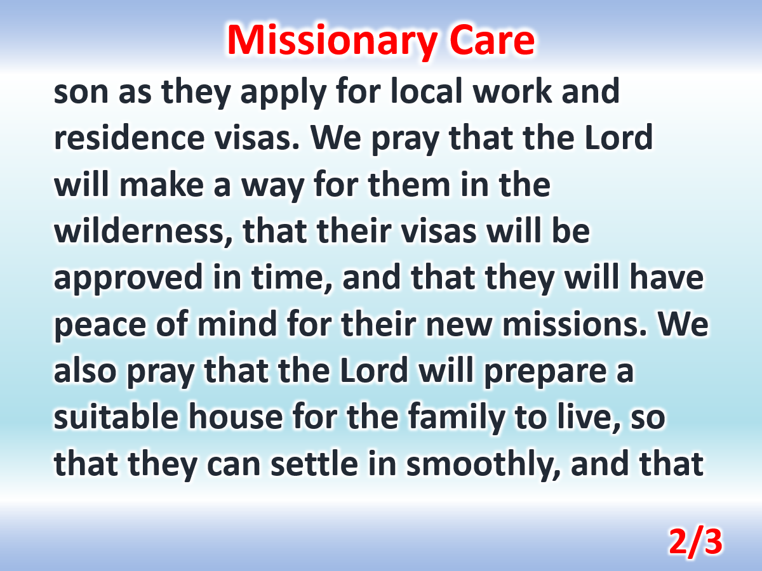

Slide 6
