Slide 1
Missionary Care
Father God, the source of all good gifts, may Your kingdom come to Japan, a country where only one percent of the population are Christians. We pray that God delivers the Japanese people from all kinds of hidden spiritual oppression in their culture, and open their eyes to receive the Only Savior, Jesus Christ. We also pray that the Holy Spirit fills
1/2

Slide 2
Missionary Care
our missionaries, Reverend Timothy and his wife Belle, anointing them to serve as evangelist and bridge-builders in their missions work in Kyoto City, Japan, reaching out to many people. Give them the patience and wisdom like Jesus to follow up every person they evangelize. In the name of our Lord Jesus Christ, Amen.
2/2

Slide 3
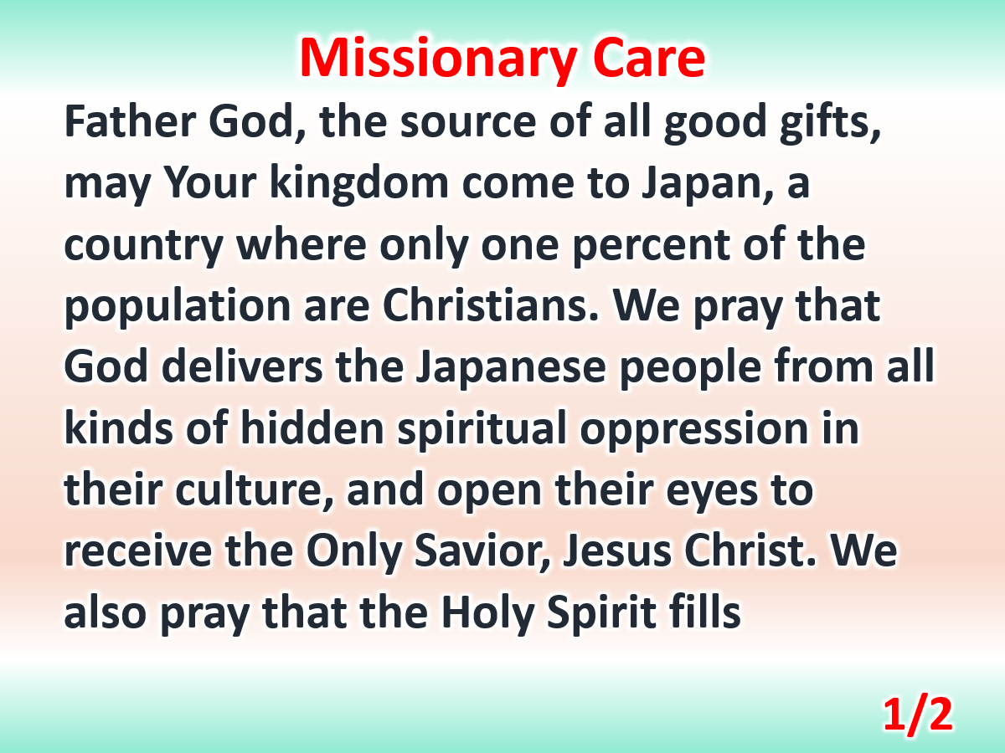

Slide 4
