Slide 1
Missionary Care
Sovereign God of the earth, may Your kingdom come to Cambodia, whose population is 17 million, but only three out of a thousand are Christians. Thank You for using Yu Chen Chen, a missionary who has been evangelizing in Cambodia for 20 years. We pray that she will be healthy and have patience and love to shepherd the Cambodian believers, training them to be fishers of men,
1/2

Slide 2
Missionary Care
especially the students in the girls' dormitory. We are thankful that brother Dunstan Tie gives one year of his time to serve as a missionary in Cambodia, while brother Ting Hua commits two months. They have shared the work of the missionaries and expanded the missionary ministry. May the Holy Spirit continue to fill them. In the name of our Lord Jesus Christ, Amen.
2/2

Slide 3
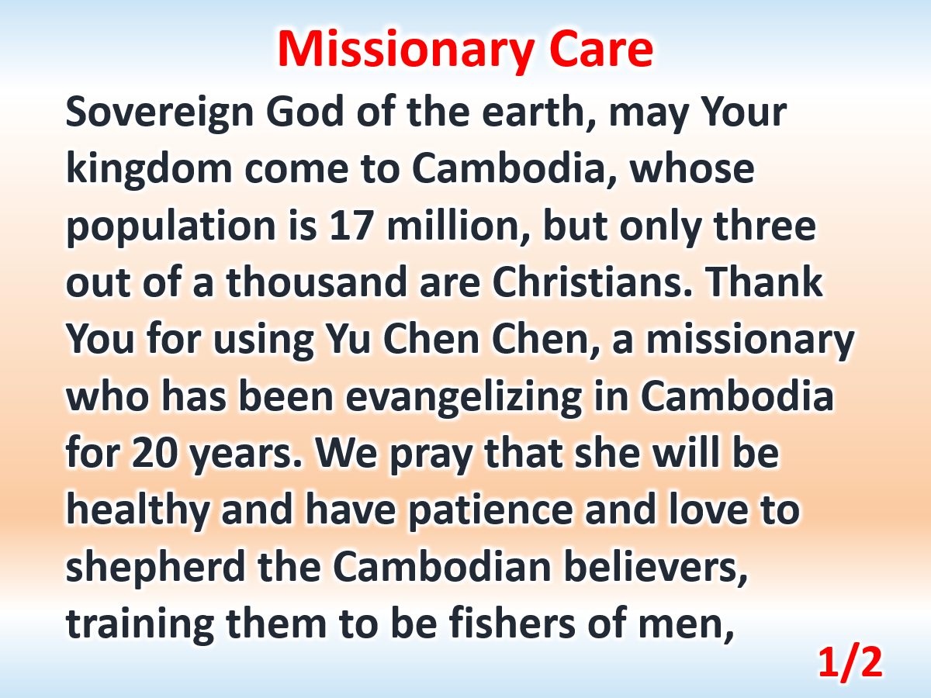

Slide 4
