Slide 1
Missionary Care
Loving God, we thank You for using the Missiology degree programme offered by the Methodist Theological School in Sibu to train brothers and sisters who have dedicated themselves to become full-time cross-cultural missionaries. We remember our risen Lord Jesus once said that the harvest is plentiful but the laborers are few. We therefore ask the Lord of the
1/2

Slide 2
Missionary Care
harvest to send more workers from the Sarawak Chinese Annual Conference to reap the harvest among the unreached people overseas and expand the Kingdom of God. May the Holy Spirit move people to dedicate themselves to become long-term missionaries and to enroll for the Missiology degree programme between July and September this year. In the name of our Lord Jesus Christ, Amen.
2/2

Slide 3
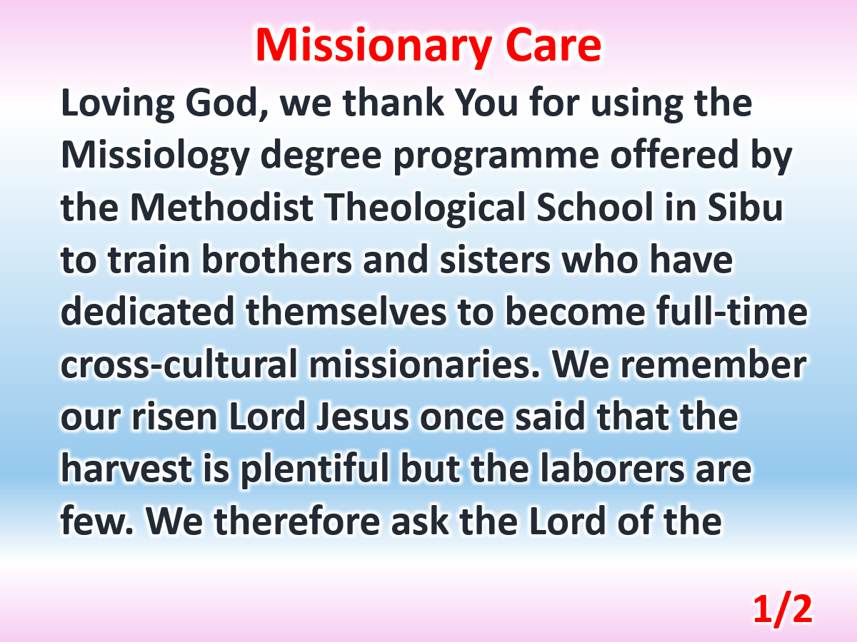

Slide 4
