Slide 1
Missionary Care
Glorious Father God, have mercy on Japan, where there is only one Christian for every one hundred people out of a population of over one hundred million. Thank You that our missionary Kathy has been evangelizing in Japan for a long time. The church she serves has recently started a new counseling ministry to help
1/3

Slide 2
Missionary Care
Japanese with mental illness and brothers and sisters in Christ. We pray that the Holy Spirit uses Kathy to effectively counsel those who come to her for help, leading them to know and experience the power of the Gospel. The church also holds a monthly free lunch for children. May the Holy Spirit use this social care ministry to
2/3

Slide 3
Missionary Care
reach out to needy children and families and share with them the abundant love of our Lord Jesus Christ. In the name of Jesus Christ, Amen.
3/3

Slide 4
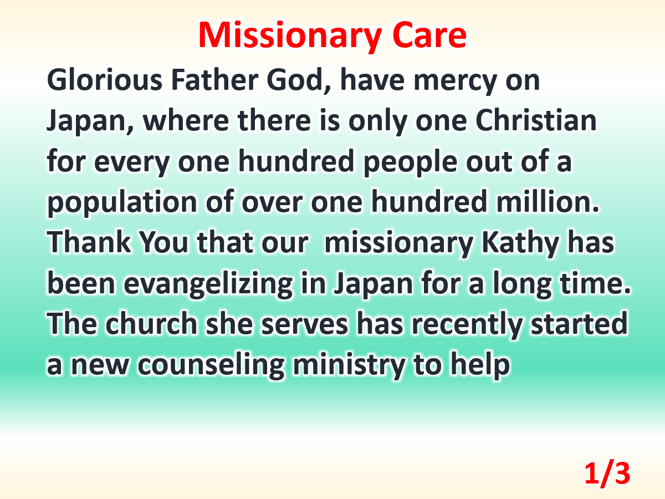

Slide 5
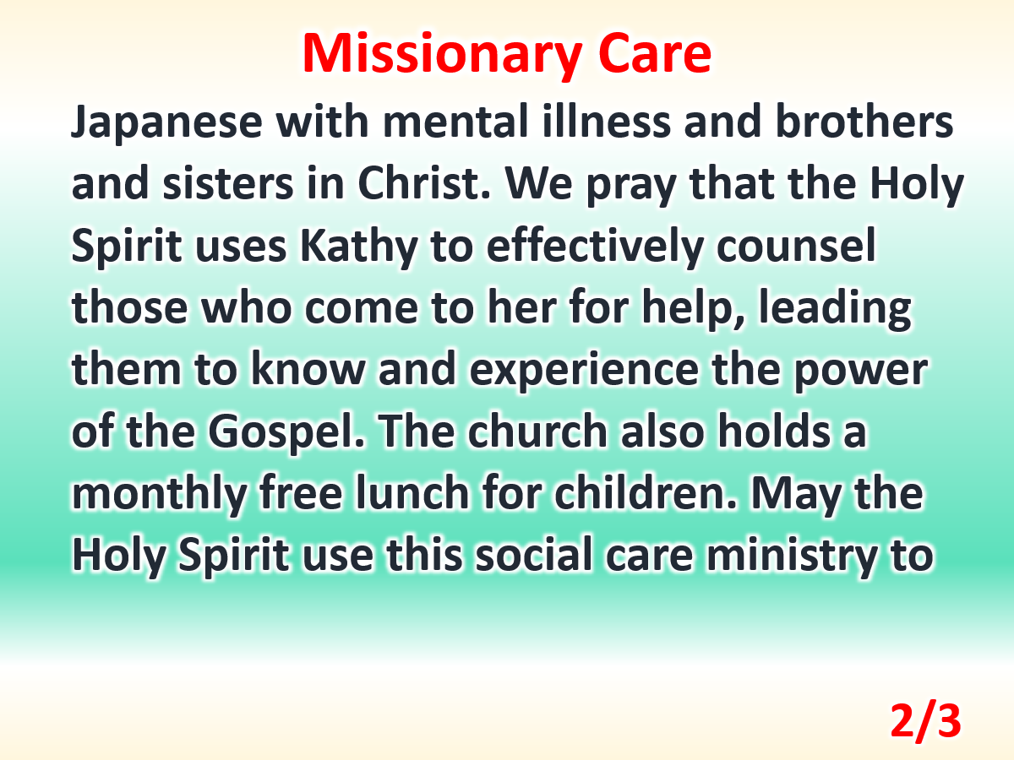

Slide 6
