Slide 1
Missionary Care
Heavenly Father, who loves the world, we thank You for using our missionary Reverend Ling Ching, who has been serving the Bilo people in Southeast Asia for many years and is fluent in their language, to translate the Bible. Recently, the translation team has been reviewing the translation of the Gospel of Matthew.
1/3

Slide 2
Missionary Care
May the Holy Spirit keep the translators and reviewers in wisdom to make sure that the translation is in line with the original meaning of the Bible and that it is easy for the Bilo people to understand. We also pray that the Bible application workshop in June and the preparation of children's Sunday school materials will be
2/3

Slide 3
Missionary Care
completed as planned, further strengthening the discipleship of the Bilo people. In the name of our Lord Jesus Christ, Amen.
3/3

Slide 4
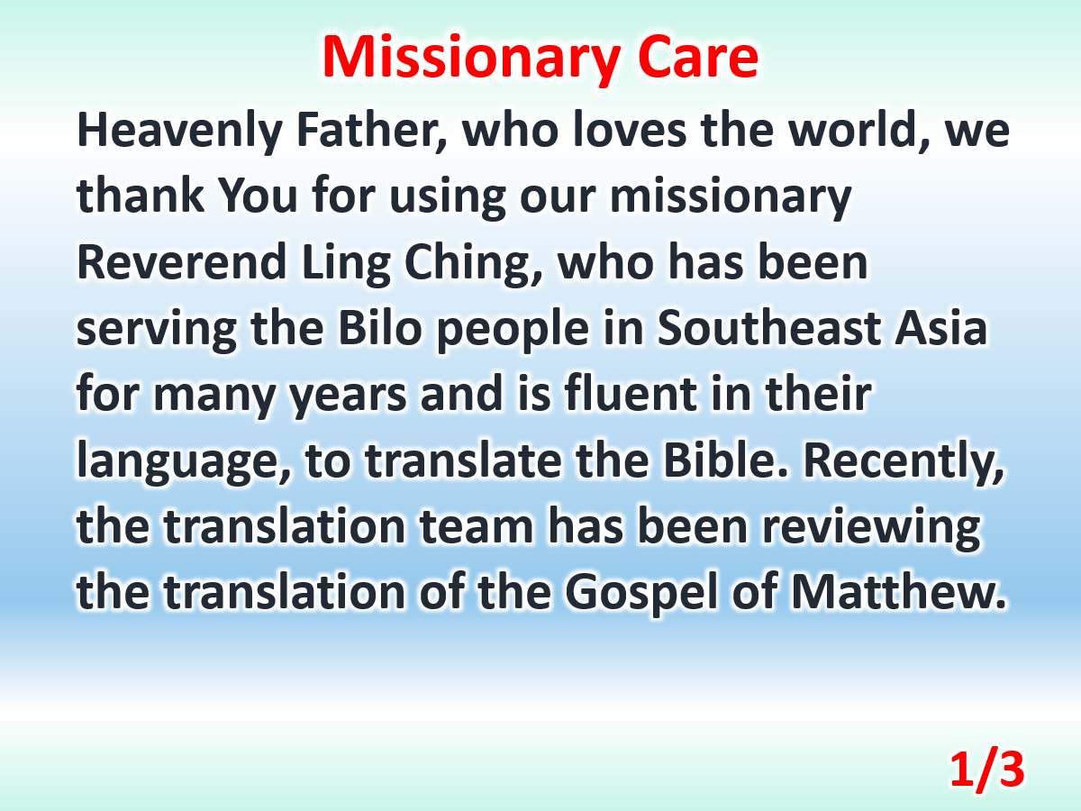

Slide 5
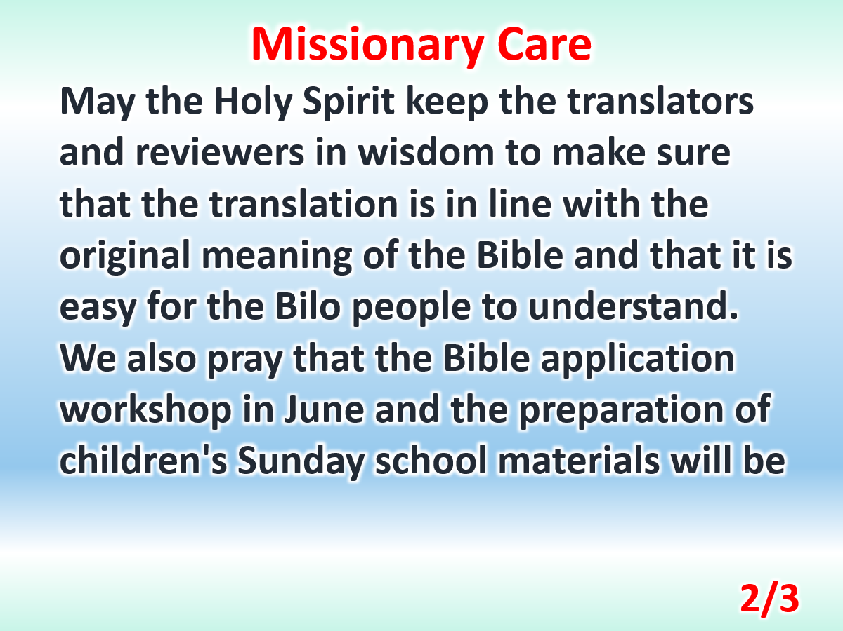

Slide 6
