Slide 1
Missionary Care
Loving Heavenly Father, we thank You for leading our missionary couple, Mr. and Mrs. Matthew and Diana, to serve in Hokkaido, Japan, with their son and daughter. In addition to the Japanese, they are also reaching out to the Ainu, the indigenous people of Hokkaido. May the Holy Spirit break down the strongholds of the powers of darkness in the hearts of
1/2

Slide 2
Missionary Care
the Ainu, that the true light of the Gospel would illuminate their worldview. Also, we ask the Holy Spirit to fill the missionary family, so that every Ainu's event they participate in would build deep friendships with the Ainu people and prepare them to accept the Gospel. In the name of our Lord Jesus Christ, Amen.
2/2

Slide 3
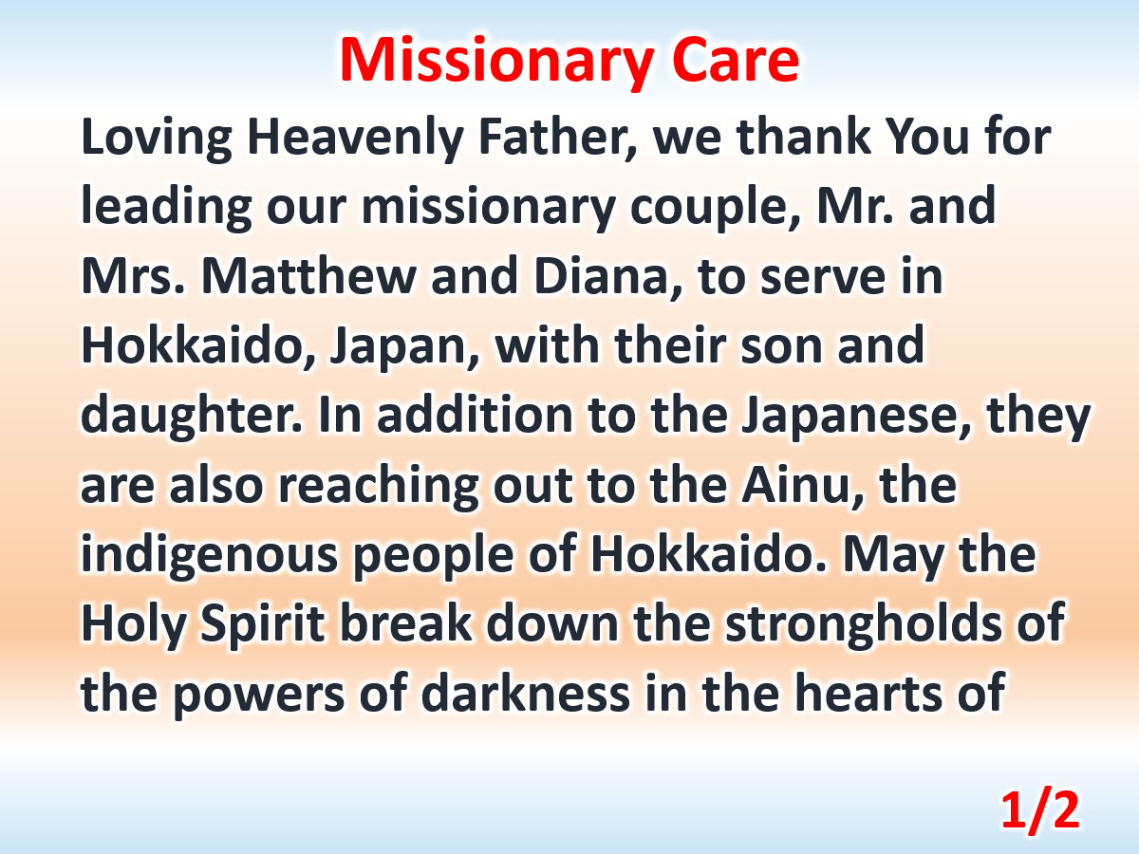

Slide 4
