Slide 1
Missionary Care
Gracious Heavenly Father, we thank You for leading our missionary Dorothy to minister to the stateless children and community in Southeast Asia. Two new co-workers have recently joined her team, Hallelujah. Dorothy is in charge of the education ministry, training and planning, and is often traveling to
1/2

Slide 2
Missionary Care
different places to spread the love of Jesus Christ. May God be her shield and strength, keeping her and her co-workers safe and effective. She is getting married at the end of May. We ask the Holy Spirit to pour out God's love in her and her husband, that they will build a happy Christian family. In the name of our Lord Jesus Christ, Amen.
2/2

Slide 3
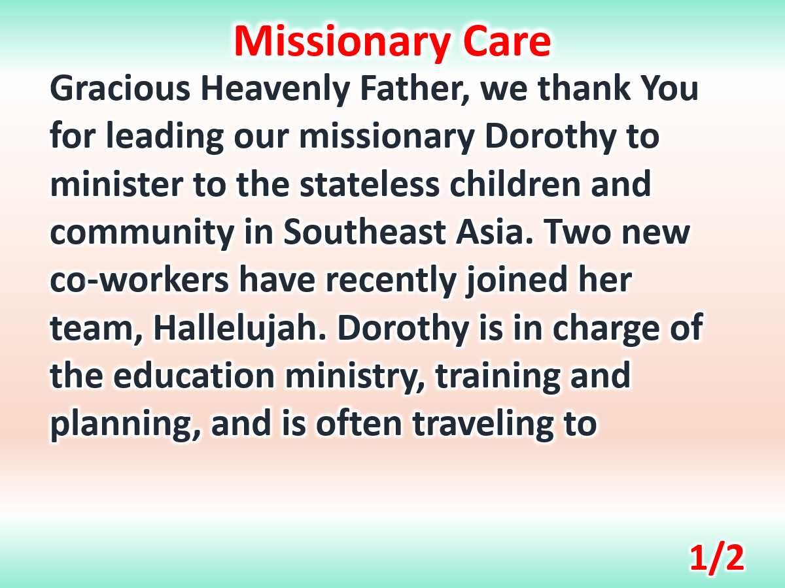

Slide 4
