Slide 1
Missionary Care
Glorious Heavenly Father, we thank You for leading Mr. and Mrs. Oreo to complete the second phase of their overseas missions and return to Sarawak for home assignment. His wife is in the process of applying for a visa, and his son is also applying for a Sarawak ID card. We pray that our Heavenly Father makes a
1/3

Slide 2
Missionary Care
way for this crucial need. During his home assignment, Mr. and Mrs. Oreo share about foreign missions in many churches. We ask the Holy Spirit to anoint them and call many to commit to foreign missions through them. Even though they are back in Sarawak, Mr. and Mrs. Oreo are still meeting online with three groups of
2/3

Slide 3
Missionary Care
believers in the missions field. We ask the Holy Spirit to fill the believers there and raise up spiritually mature local Christians to become leaders. In the name of our Lord Jesus Christ, Amen.
3/3

Slide 4
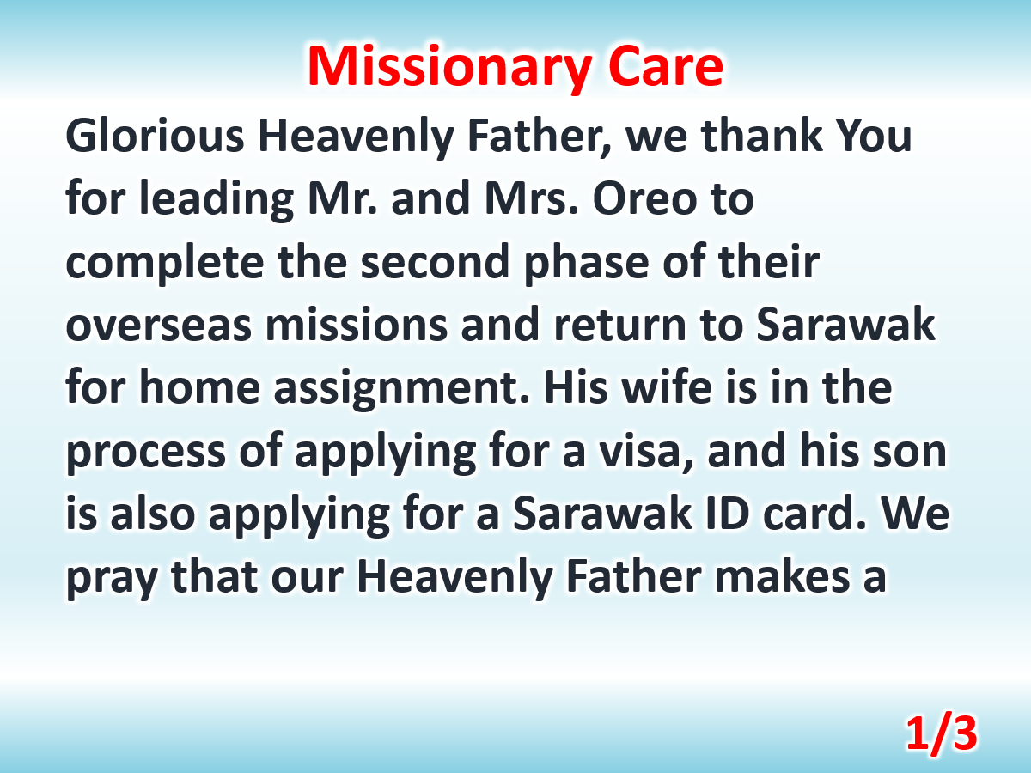

Slide 5
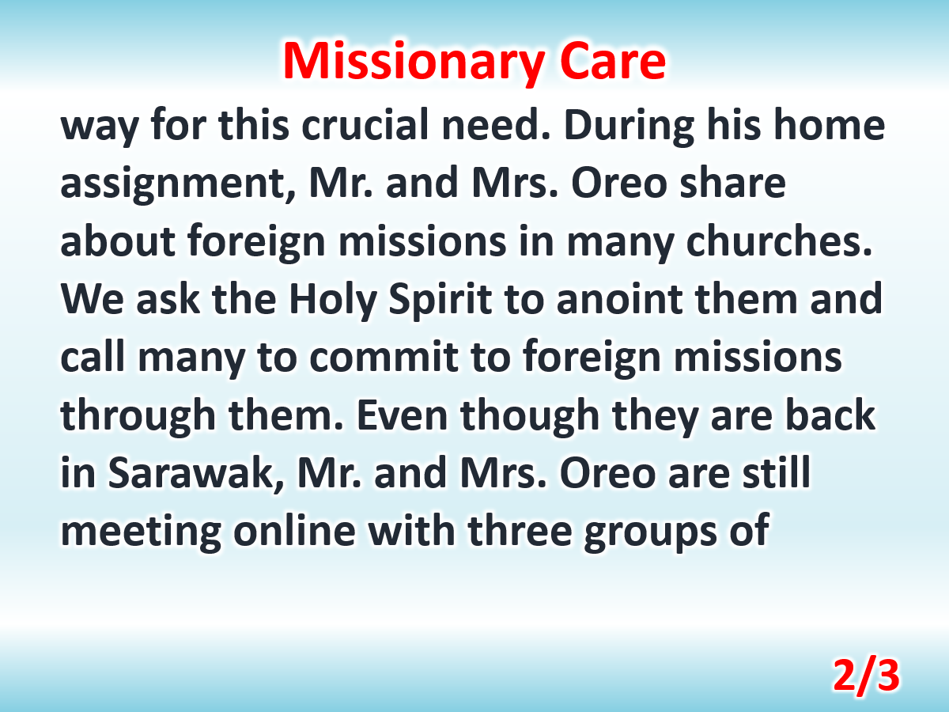

Slide 6
