Slide 1
Missionary Care
Heavenly Father, we thank You for sending Reverend Timothy and Mrs. Belle to Japan for their ninth year of missionary service. With only one percent of Japan's 120 million people being Christians, we call on our Father to anoint Reverend and Mrs. Timothy to effectively preach and nurture new believers in Japan. TOMO, which they run, held its second spring
1/3

Slide 2
Missionary Care
children's English camp at the end of March during the school vacation. Hallelujah, the attendance of the students at the three-day camp was 100 percent. We pray that these attendees and parents would be more and more open to the Gospel of Christ and would trust in the Lord Jesus as their Savior as the missionaries follow up. We ask the
2/3

Slide 3
Missionary Care
Holy Spirit to fill Reverend and Mrs Timothy's two children, their daughter who is entering 3rd grade, and their son who is entering the Kindergarten, blessing them to be God-fearing persons who will shine in Japan with their parents. In the name of our Lord Jesus Christ, Amen.
3/3

Slide 4
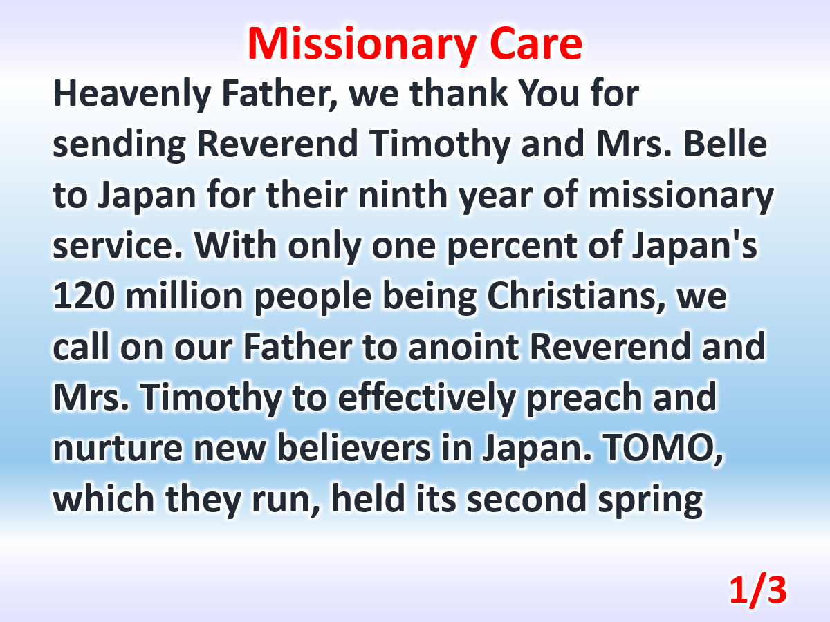

Slide 5
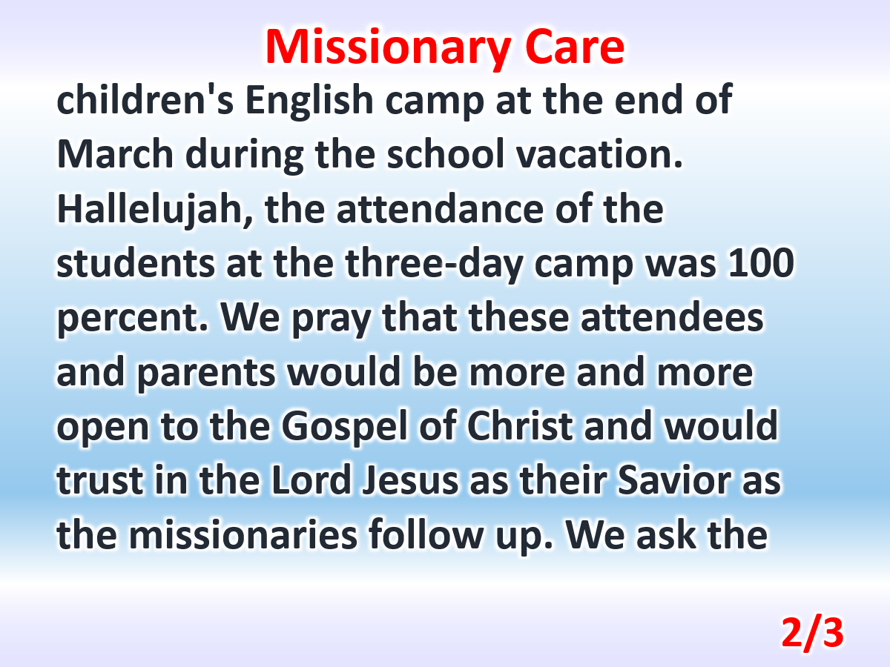

Slide 6
