Slide 1
Missionary Care
Heavenly Father who cares for the poor, we thank You for sending Jacky and his wife Iris as missionaries to the refugee community. Most of their contacts are with refugees without legal status, illegal overstayers and stateless people. Recently, many illegal foreign workers have been arrested, many of whom are
1/3

Slide 2
Missionary Care
parents and relatives of the missionaries' students. We ask the Holy Spirit to empower Jacky and Iris that they are able to cope with various situations and events wisely, and to sow the seeds of the Gospel among the refugees through education and social care. Jacky is currently preparing for the Refugee
2/3

Slide 3
Missionary Care
Learning Centers' inter-school speech contest. May the Holy Spirit use this program to broaden the knowledge and enhance the growth of the refugee children. In the name of our Lord Jesus Christ, Amen.
3/3

Slide 4
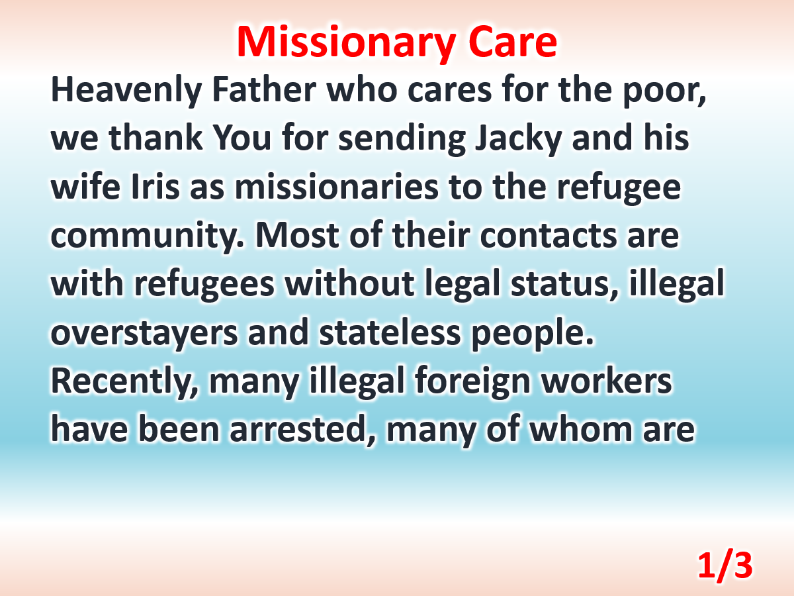

Slide 5
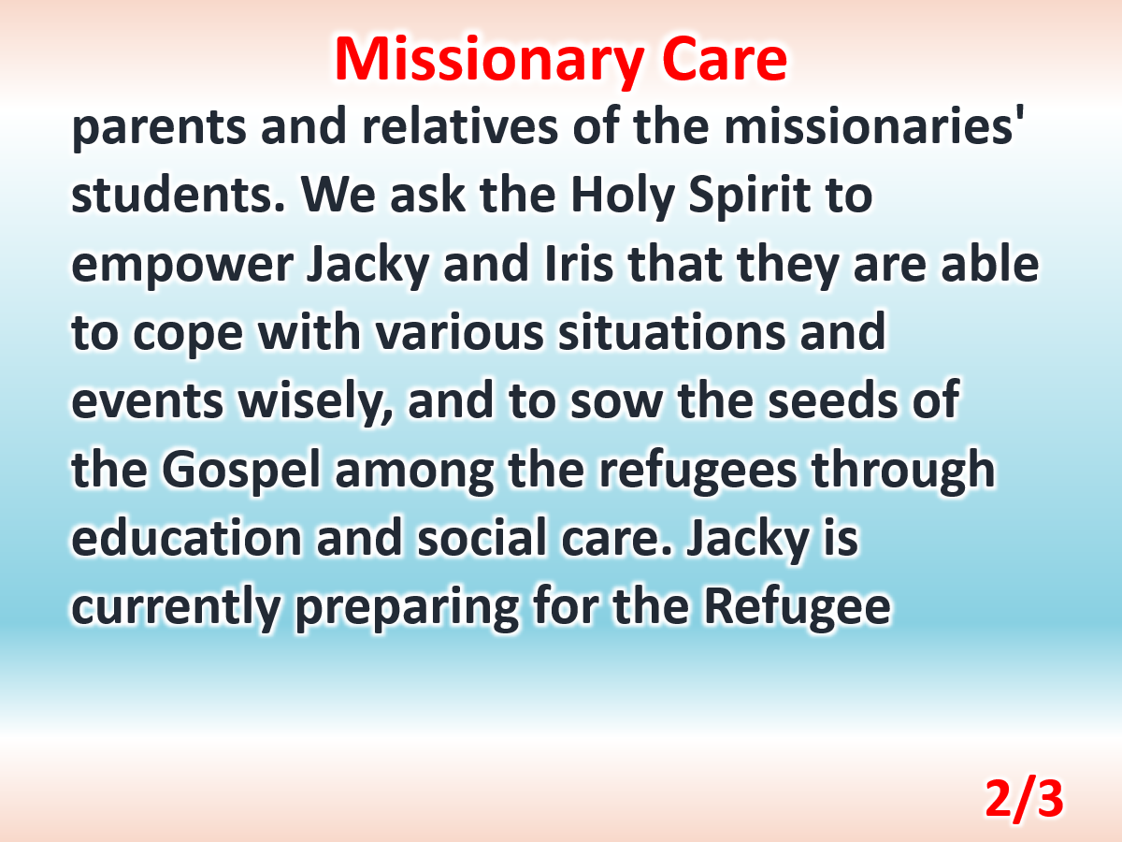

Slide 6
