Slide 1
Missionary Care
Almighty Father, we praise You for using our missionary Lydia in ministering to the unreached people groups in Indochina. In the new semester this year, many new students enter Lydia's learning center. She teaches two classes of fifty students. May God give Lydia Christlike love and patience to teach the local people and build good relationships with them, so that every
1/3

Slide 2
Missionary Care
heart will become good soil for the seeds of the Gospel to grow. Recently there has been an influx of Chinese people into the city where Lydia lives, some marrying locals, some purchasing rare earth minerals and running catering businesses, and some attempting to defraud and abduct children and young girls. Have mercy on the locals, O God, and keep them wise in
2/3

Slide 3
Missionary Care
discernment, so that they will not be deceived. Lydia is currently discipling a new convert. May the Holy Spirit fill this new believer and she will become a faithful disciple of Jesus Christ. In the name of our Lord Jesus Christ, Amen.
3/3

Slide 4
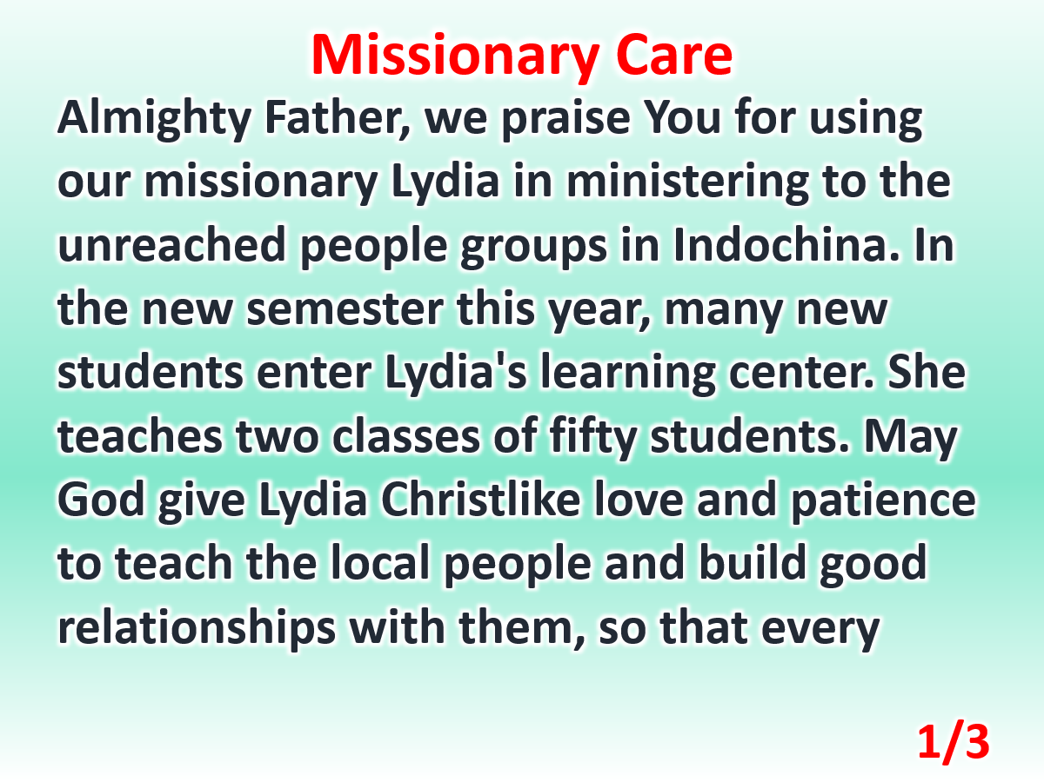

Slide 5
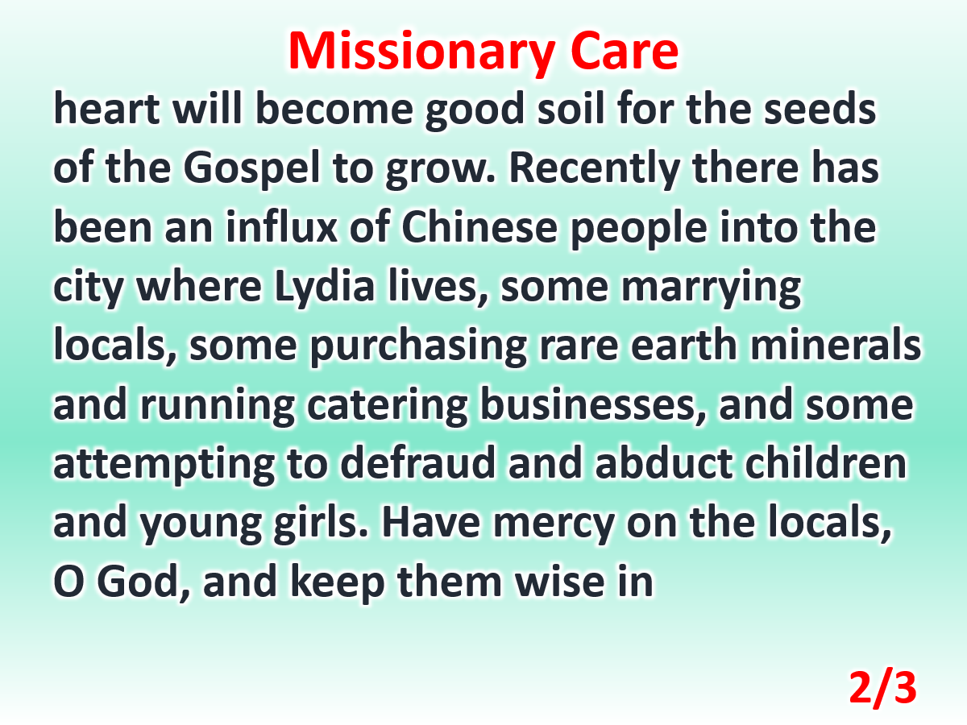

Slide 6
