Slide 1
Missionary Care
Heavenly Father, thank You for looking after our missionary in Thailand, Chieng, who is spreading Gospel among the 70 million souls. We are thankful for her safety during the earthquake that occurred at the end of March in Myanmar. We ask God to bless the relief and reconstruction works in Myanmar and Thailand, and for Christians to take
1/3

Slide 2
Missionary Care
an active part in it, showing the image of Christ's mercy in the affected areas. We also pray for the Holy Spirit to help Chieng bearing good testimony in the Thai school where she has just finished her first year of teaching. A M-lady whom Chieng cares for is currently facing a health and family crisis. May the Holy Spirit open the eyes of this lady so that
2/3

Slide 3
Missionary Care
she may encounter the light and peace of Jesus Christ. O God, may You send more short-term and long-term missionaries to the fields in Thailand. In the name of our Lord Jesus Christ, Amen.
3/3

Slide 4
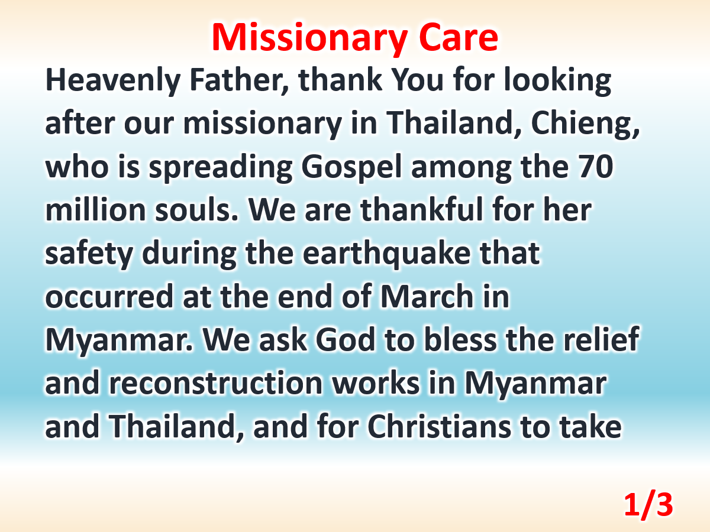

Slide 5
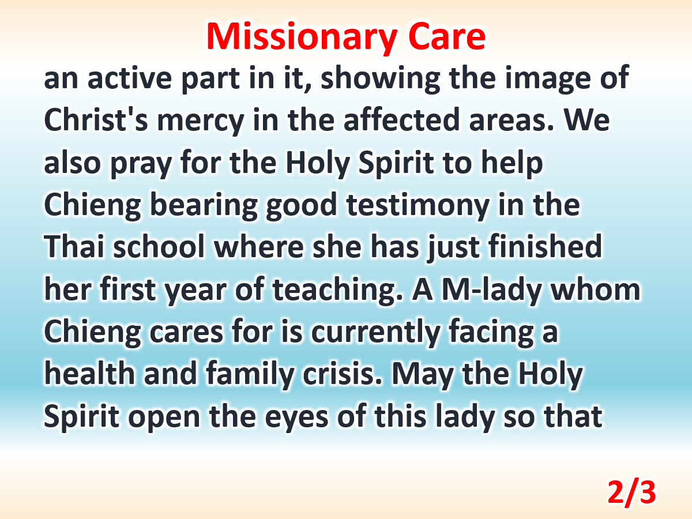

Slide 6
