Slide 1
Missionary Care
Holy Father in heaven, thank You for leading our missionary couple, Reverend and Mrs. Nguang Ung Soon, to actively reach out to the 270,000 Hokkien people living in the United Kingdom. They are preparing to visit the capital city of London and the southern port city of Portsmouth in May and June to promote evangelism to the Hokkien people.
1/3

Slide 2
Missionary Care
We pray that the Holy Spirit will fill them, make them fishers of men and raise up mature Christian leaders among the Hokkien people. Epsom Methodist Church, pastored by Reverend and Mrs. Nguang Ung Soon, will hold election for new leaders in April. May the Holy Spirit guide the nomination and election process. That the elected brothers and sisters will gladly
2/3

Slide 3
Missionary Care
take up their crosses, offer their spiritual gifts, and build up the body of Christ in unity. In the name of our Lord Jesus Christ, Amen.
3/3

Slide 4
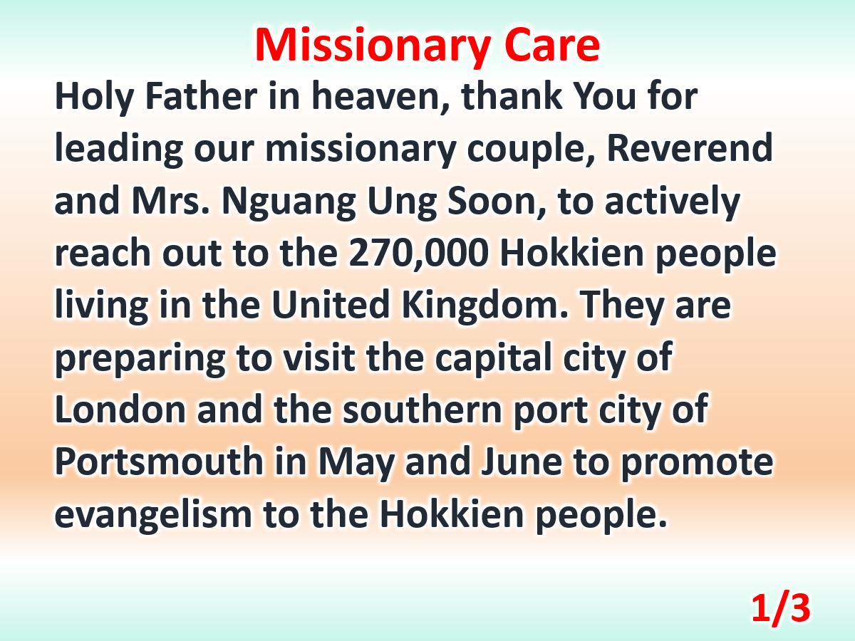

Slide 5
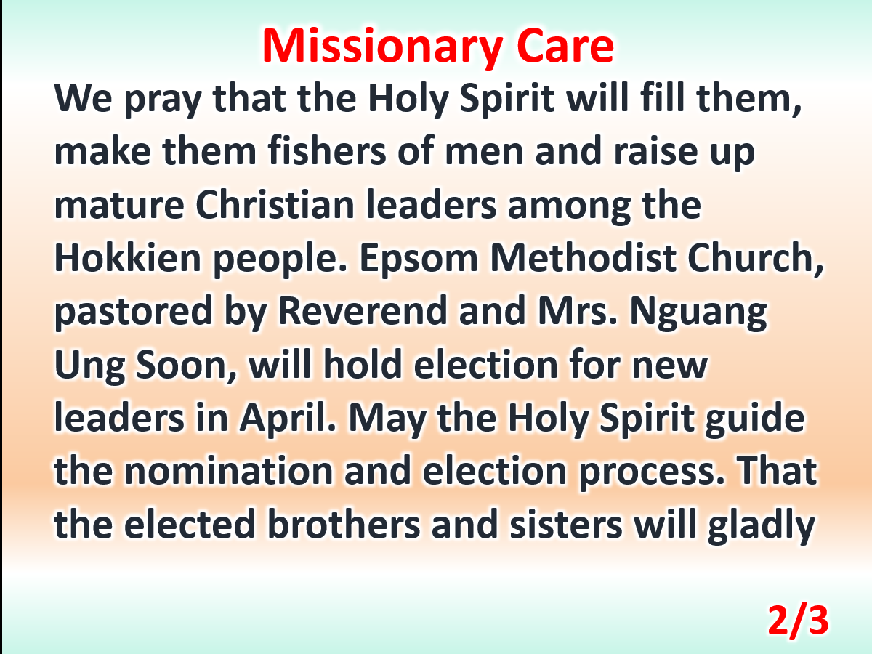

Slide 6
