Slide 1
Missionary Care
Almighty and all-knowing Heavenly Father, thank You for using our long term missionary, Kathy, to serve in East Osaka, Japan, where she is working with the pastor of Elim Christian Church. It is very difficult to evangelize in Japan. We ask God to strengthen the church so as to be strong in their evangelistic strategy in the new year, that our Japanese brothers and
1/2

Slide 2
Missionary Care
sisters will be full of faith in witnessing to Jesus Christ with their words and deeds. We also ask God to bless the elders of the church, giving them good health to continue nurturing the younger generation of believers in the church. May the Holy Spirit fill Kathy, that she will be healed of her asthma and thyroid condition. In the name of our Lord Jesus Christ, Amen.
2/2

Slide 3
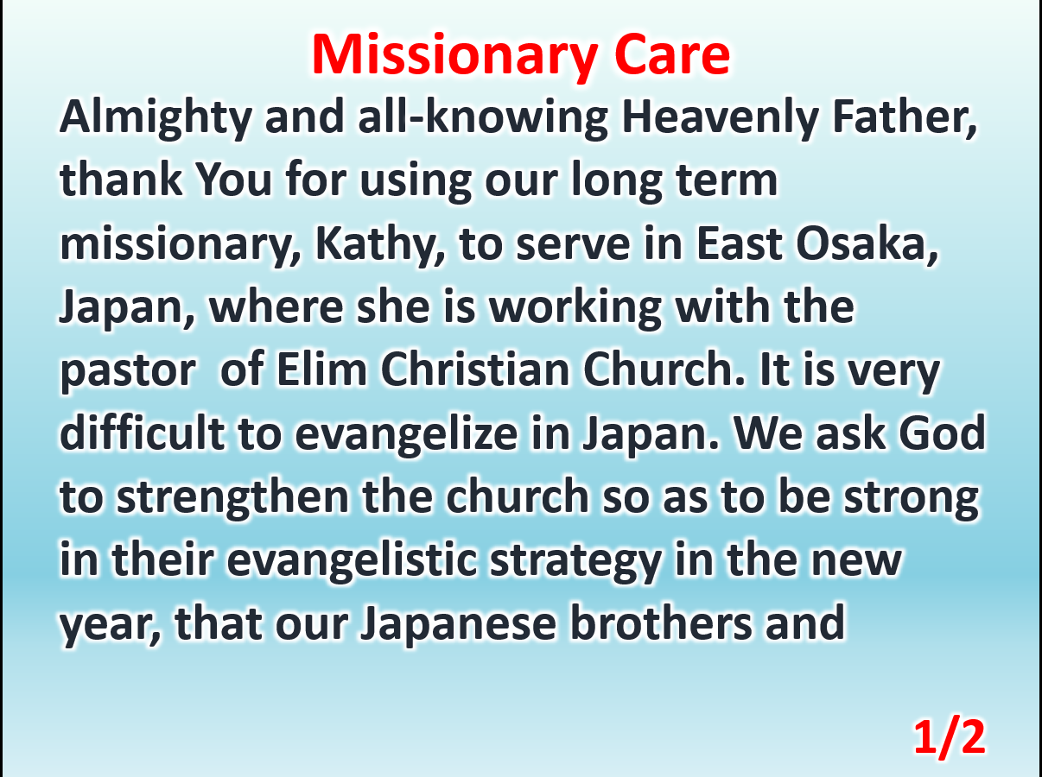

Slide 4
